Slide 1
HOUSE PRICE PREDICTION PROJECT
SUBMITTED BY :
Swati Pandey

Slide 2
INTRODUCTION BUSINESS PROBLEM FRAMING
Houses are one of the necessary needs of each and every person around the globe and therefore housing and real estate market is one of the markets which is one of the major contributors in the world’s economy. It is a very large market and there are various companies working in the domain.
Data science comes as a very important tool to solve problems in the domain to help the companies increase their overall revenue, profits, improving their marketing strategies and focusing on changing trends in house sales and purchases. Predictive modelling, Market mix modelling, recommendation systems are some of the machine learning techniques used for achieving the business goals for housing companies. Our problem is related to one such housing company.
We are required to model the price of houses with the available independent variables. This model will then be used by the management to understand how exactly the prices vary with the variables. They can accordingly manipulate the strategy of the firm and concentrate on areas that will yield high returns. Further, the model will be a good way for the management to understand the pricing dynamics of a new market

Slide 3
CONCEPTUAL BACKGROUND OF THE DOMAIN PROBLEM
A US-based housing company named Surprise Housing has decided to enter the Australian market. The company uses data analytics to purchase houses at a price below their actual values and flip them at a higher price. For the same purpose, the company has collected a data set from the sale of houses in Australia. The data is provided in the CSV file below.
The company is looking at prospective properties to buy houses to enter the market. You are required to build a model using Machine Learning in order to predict the actual value of the prospective properties and decide whether to invest in them or not. For this company wants to know:
• Which variables are important to predict the price of a variable?
• How do these variables describe the price of the house?

Slide 4
MOTIVATION OF THE PROBLEM UNDERTAKEN
My main objective of doing this project is to build a model to predict the house prices with the help of other supporting features. I am going to predict by using Machine Learning algorithms.
The sample data is provided to us from our client database. In order to improve the selection of customers, the client wants some predictions that could help them in further investment and improvement in selection of customers.
House Price Index is commonly used to estimate the changes in housing price. Since housing price is strongly correlated to other factors such as location, area, population, it requires other information apart from HPI to predict individual housing price.
There has been a considerably large number of papers adopting traditional machine learning approaches to predict housing prices accurately, but they rarely concern themselves with the performance of individual models and neglect the less popular yet complex models.

Slide 5
ANALYTICAL PROBLEM FRAMING MATHEMATICAL/ANALYTICAL MODELLING OF THE PROBLEM
I am building a model in Machine Learning to predict the actual value of the prospective properties and decide whether to invest in them or not. So, this model will help us to determine which variables are important to predict the price of variables & also how do these variables describe the price of the house. This will help to determine the price of houses with the available independent variables. They can accordingly manipulate the strategy of the firm and concentrate on areas that will yield high returns.
Regression analysis is a set of statistical processes for estimating the relationships between a dependent variable (often called the 'outcome variable') and one or more independent variables (often called 'predictors', 'covariates', or 'features'). The most common form of regression analysis is linear regression, in which one finds the line (or a more complex linear combination) that most closely fits the data according to a specific mathematical criterion. For specific mathematical reasons this allows the researcher to estimate the conditional expectation of the dependent variable when the independent variables take on a given set of values.
Regression analysis is also a form of predictive modelling technique which investigates the relationship between a dependent (target) and independent variable (predictor). This technique is used for forecasting, time series modelling and finding the causal effect relationship between the variables.

Slide 6
The different Mathematical/Analytical models that are used in this project are as below:
Linear Regression, Lasso, Ridge, SupportVectorRegressor, KNeighborsRegressor, Decision Tree Regressor, Random
Forest Regressor, Adaboost Regressor, GradientBoostingRegressor
First, use the train dataset and do the EDA process, fitting the best model and saving the model.
Then, use the test dataset, load the saved model and predict the values over the test data.

Slide 7
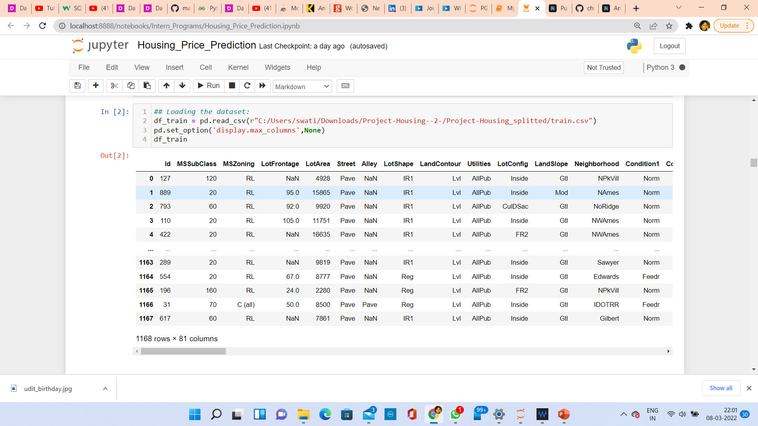
DATA SOURCES AND THEIR FORMATS

Slide 8
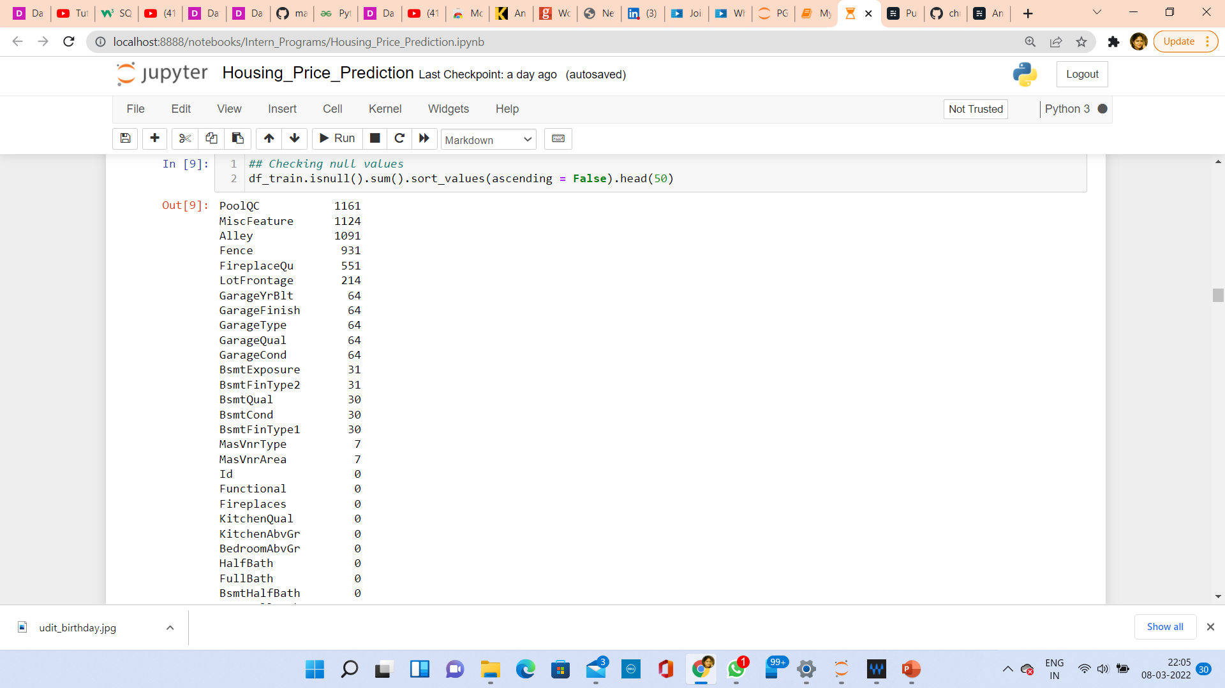
CHECKING THE NUMBER OF NULL VALUES IN THE DATASET

Slide 9
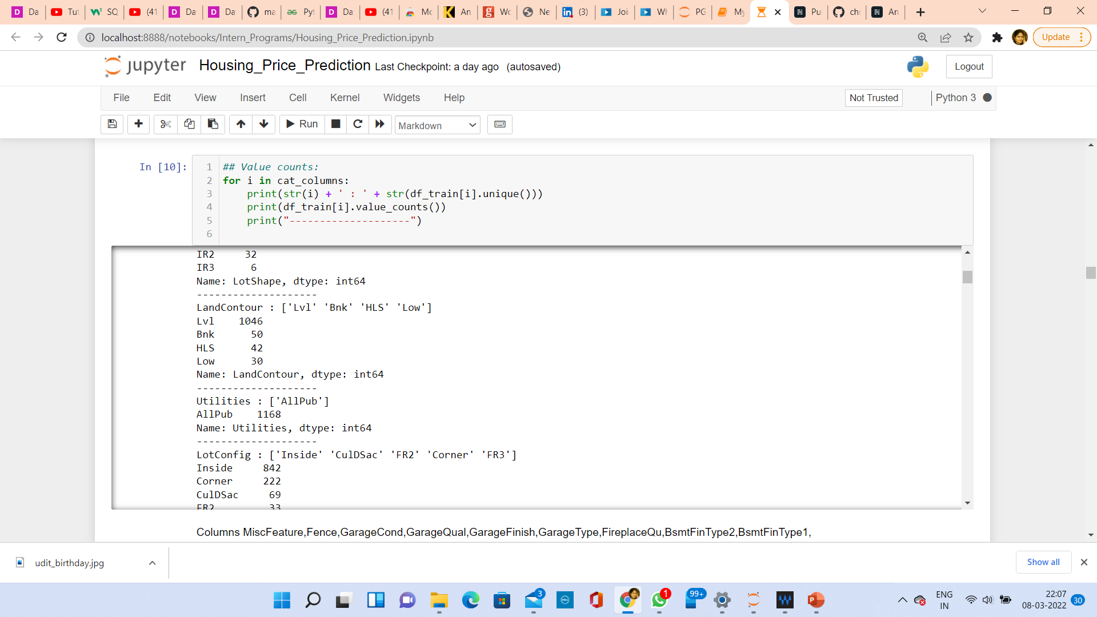
DATA PREPROCESSING
Data pre-processing in Machine Learning refers to the technique of preparing (cleaning and organizing) the raw data to make it suitable for a building and training Machine Learning models. In other words, whenever the data is gathered from different sources it is collected in raw format which is not feasible for the analysis. Data pre-processing is an integral step in Machine Learning as the quality of data and the useful information that can be derived from it directly affects the ability of our model to learn; therefore, it is extremely important that we pre- process our data before feeding it into our model.
CHECKING THE VALUE COUNTS OF CATEGORICAL DATA

Slide 10
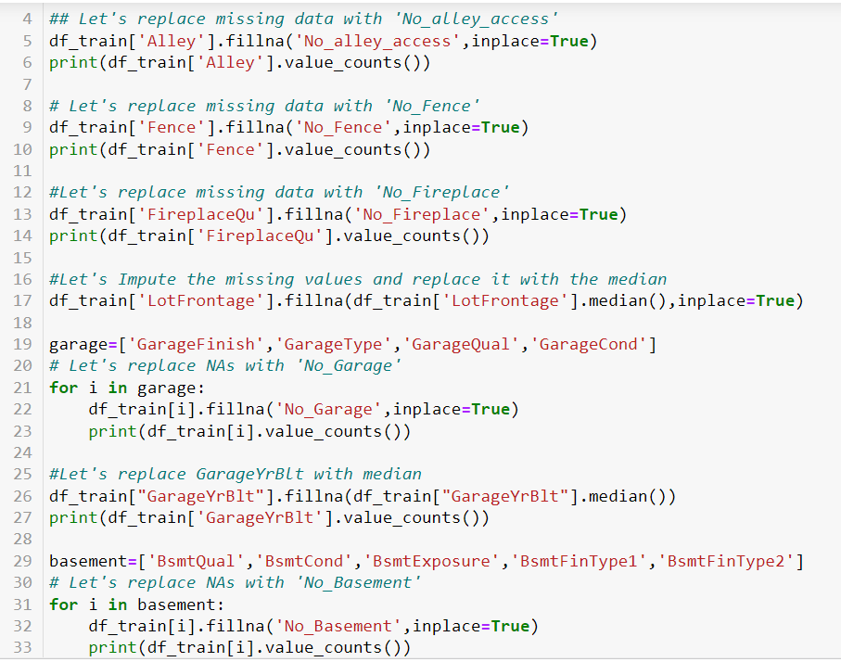
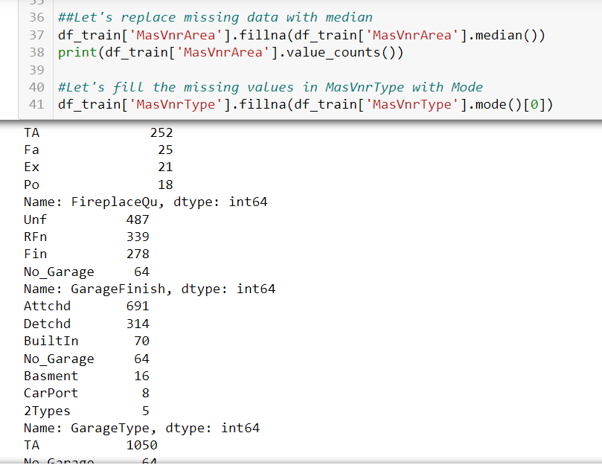
HANDLING MISSING DATA

Slide 11
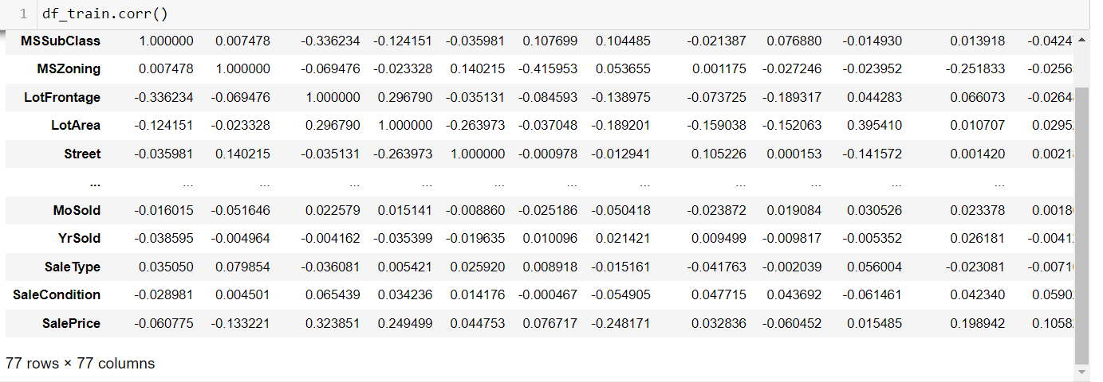
CORRELATION FACTOR
The statistical relationship between two variables is referred to as their correlation. The correlation factor represents the relation between columns in a given dataset. A correlation can be positive, meaning both variables are moving in the same direction or it can be negative, meaning that when one variable's value increasing, the other variable’s value is decreasing.

Slide 12
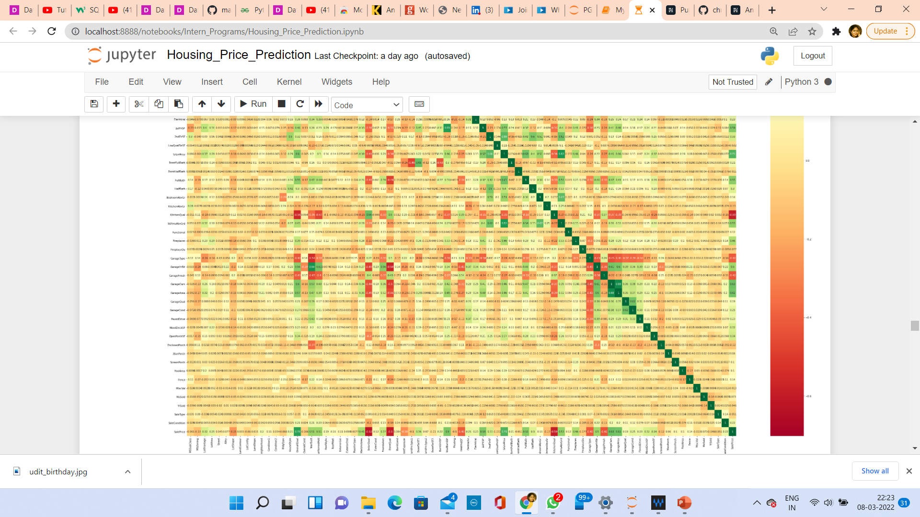
CORRELATION MATRIX AND ITS VISUALIZATION
A correlation matrix is a tabular data representing the ‘correlations’ between pairs of variables in a given dataset. It is also a very important pre-processing step in Machine Learning pipelines. The Correlation matrix is a data analysis representation that is used to summarize data to understand the relationship between various different variables of the given dataset.

Slide 13
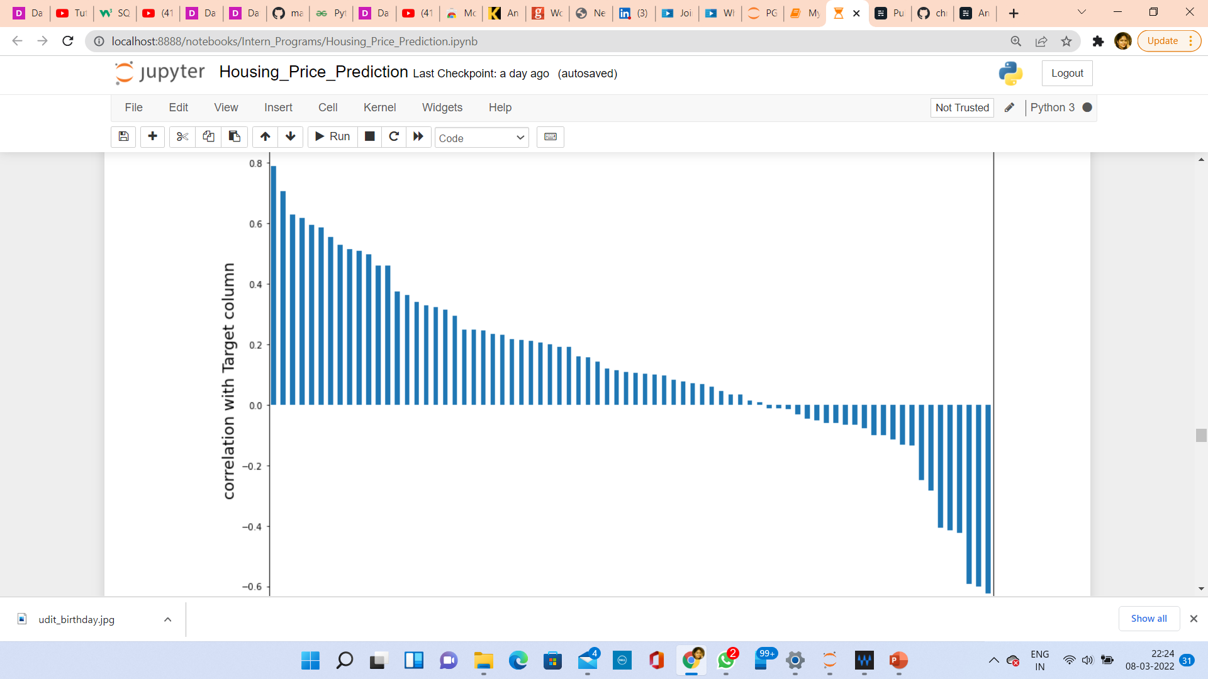
CORRELATION WITH TARGET VARIABLE
OverallQual,GrLivArea,GarageCars,GarageArea these columns have strong relationship with target column.
3SsnPorch,Street,Condition2,LandContour,MasVnrType,LandSlope columns have very weak relationship with target column.
There are 24 columns ,which are negatively correlated with target column.

Slide 14
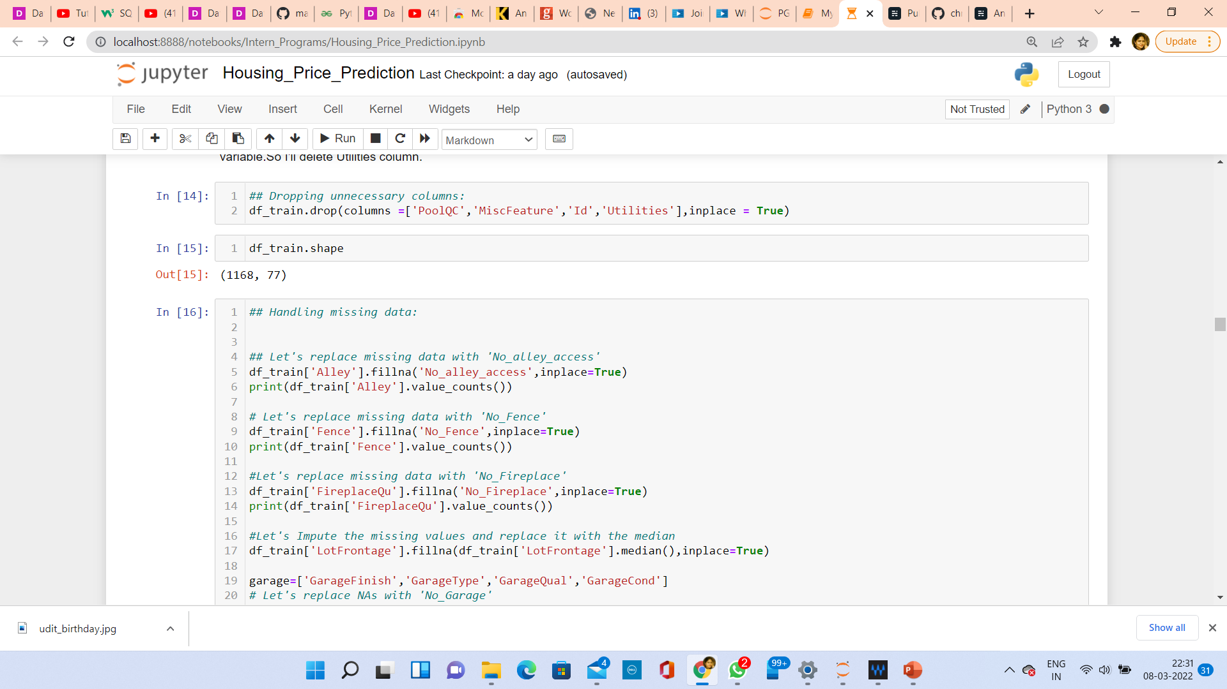
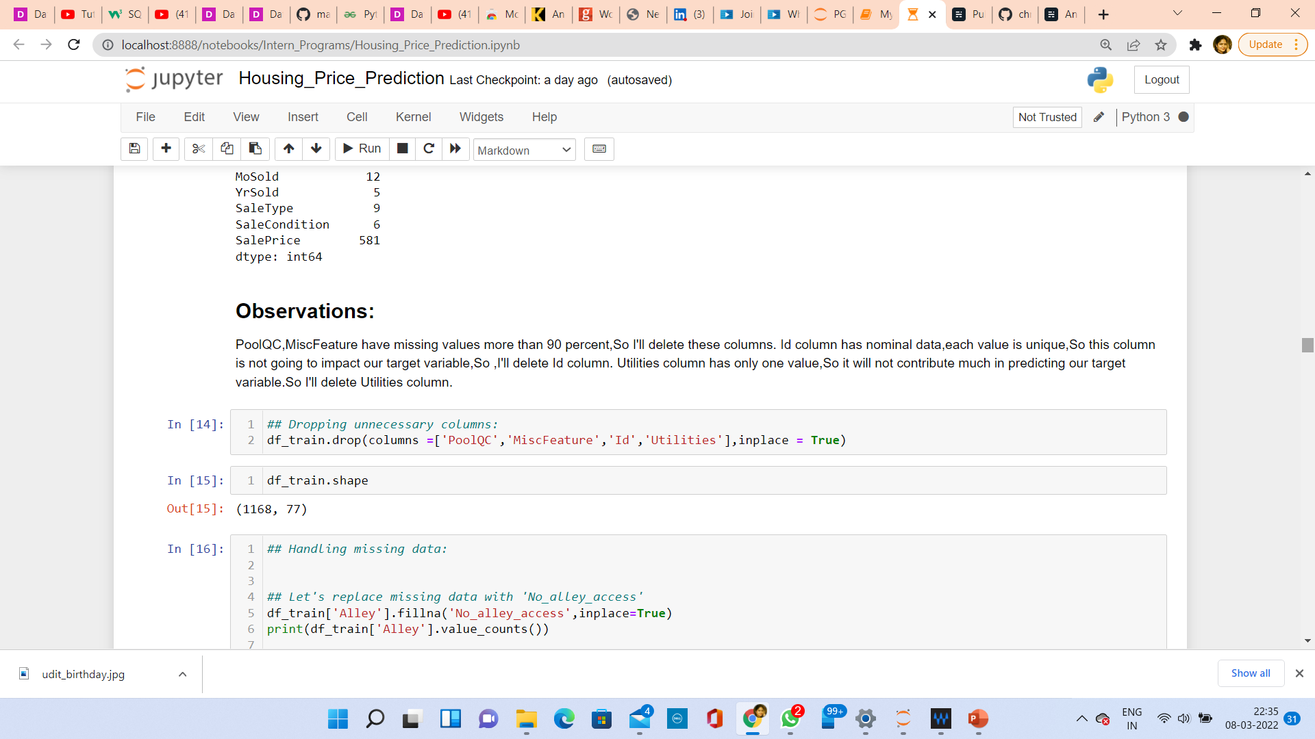
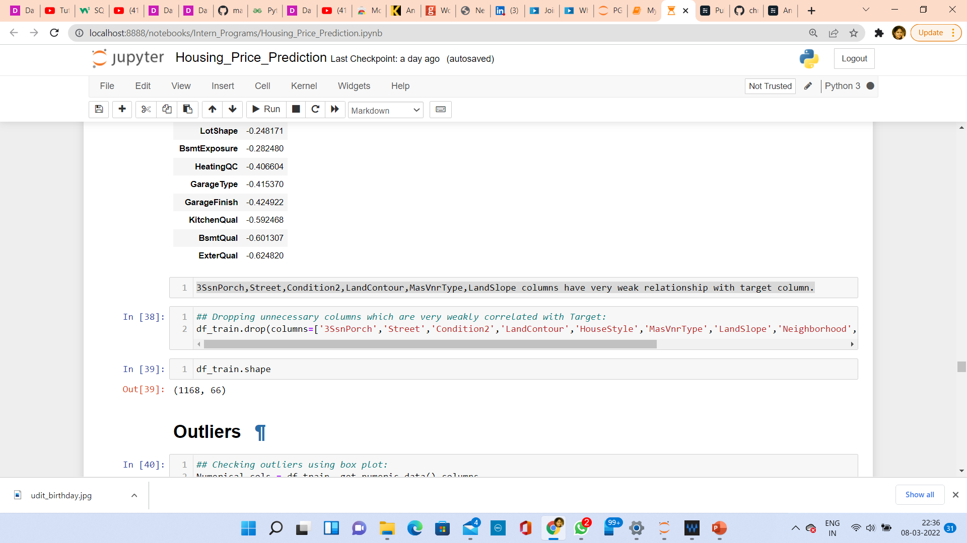
DROPPING UNNECESSARY COLUMNS

Slide 15
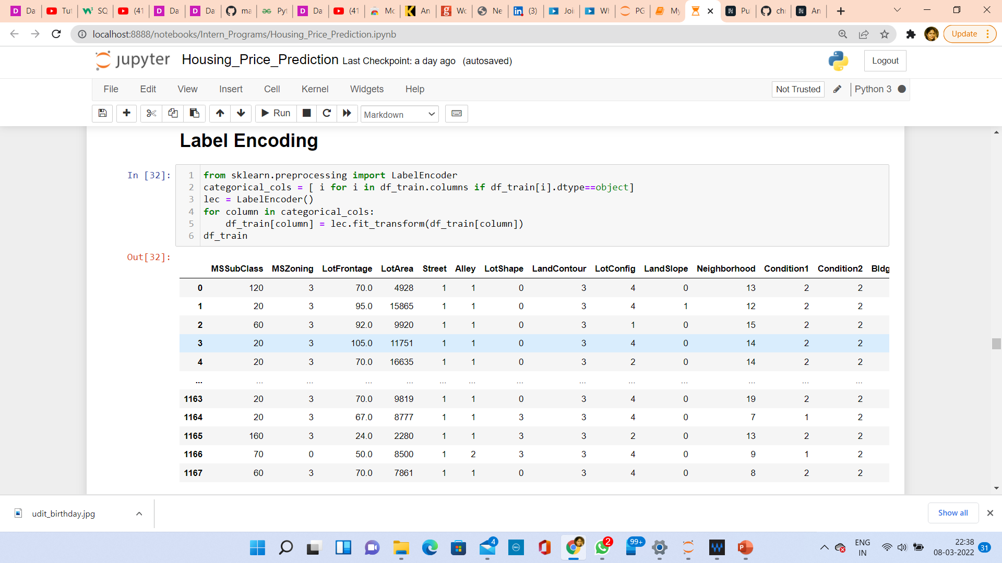
Label Encoding

Slide 16
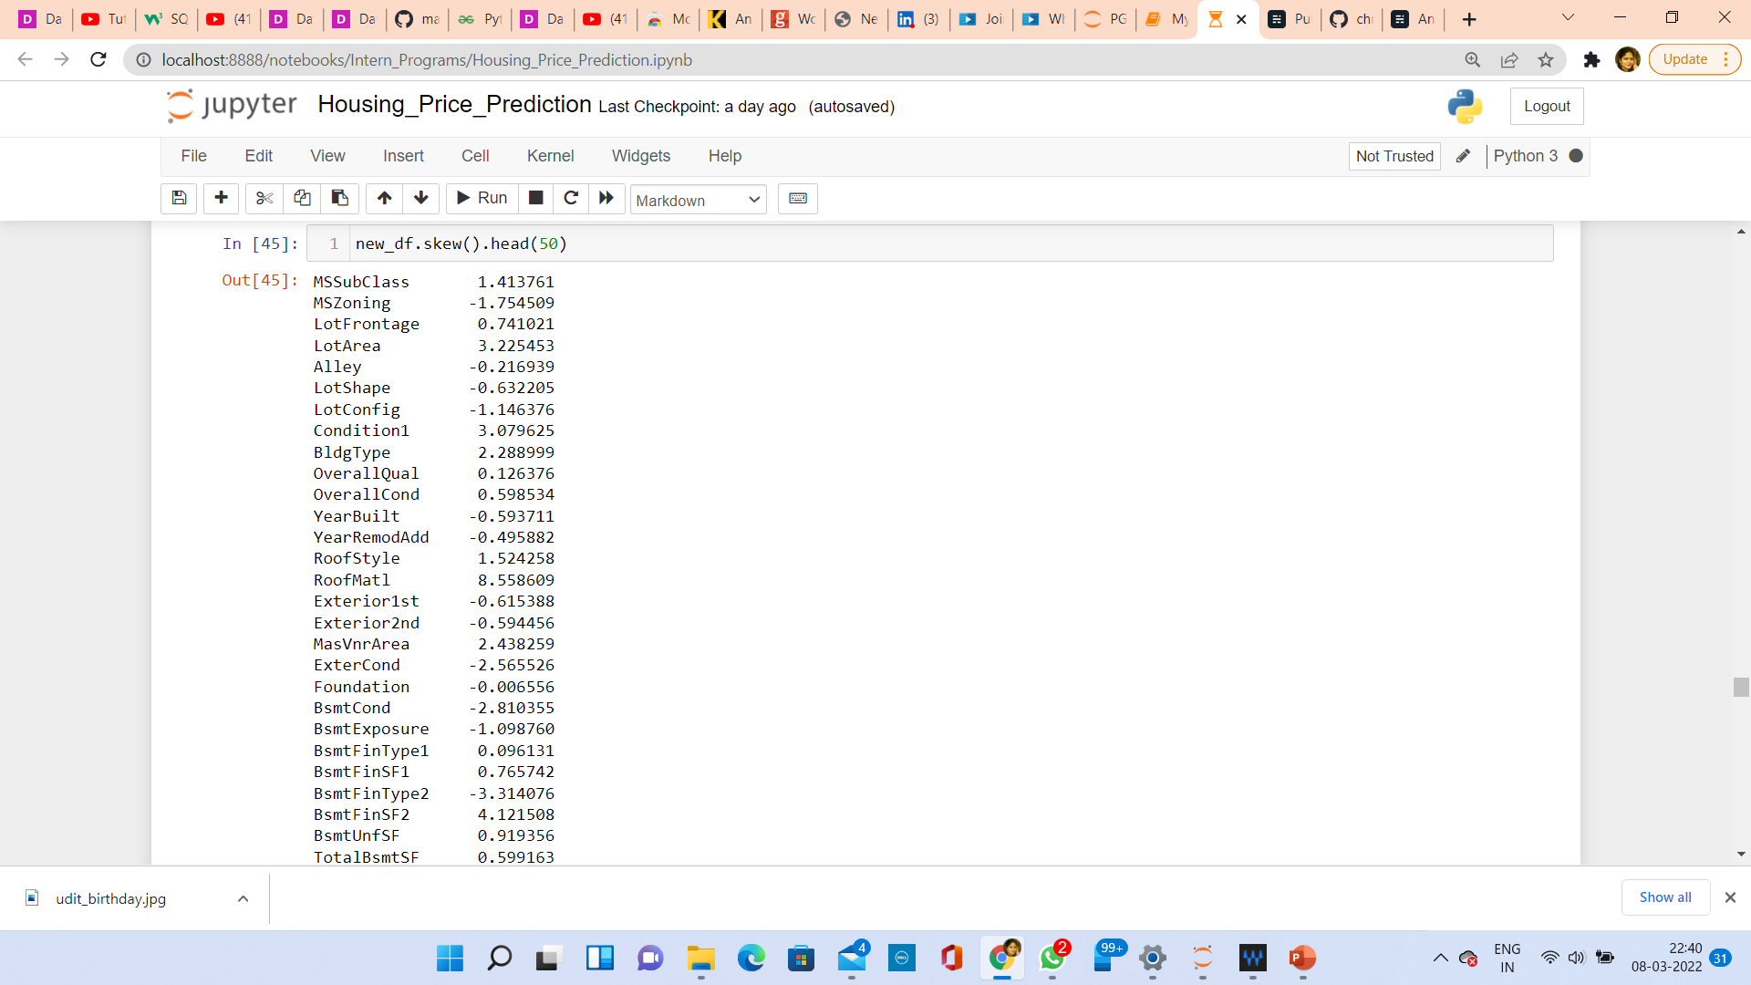
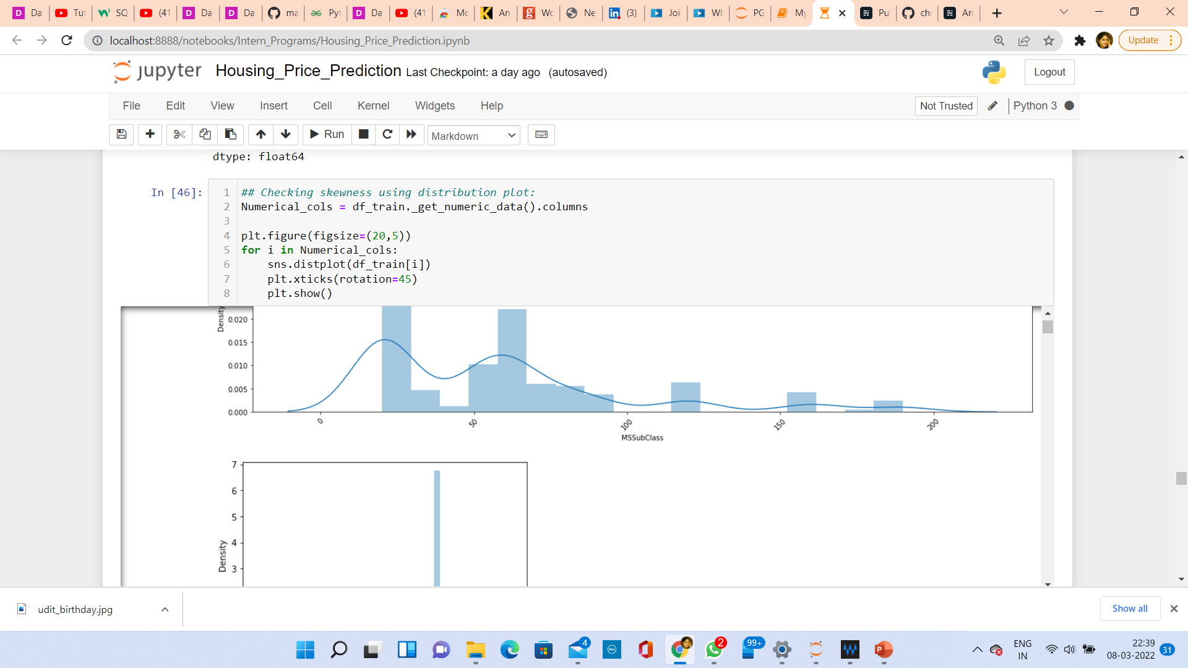
CHECKING SKEWNESS AND PLOTTING DIST PLOT
Skewness refers to distortion or asymmetry in a symmetrical bell curve, or normal distribution in a set of data. Besides positive and negative skew, distributions can also be said to have zero or undefined skew. The skewness value can be positive, zero, negative, or undefined.

Slide 17
CHECKING OUTLIERS AND PLOTTING IT
An outlier is a data point in a data set which is distant or far from all other observations available. It is a data point which lies outside the overall distribution which is available in the dataset. In statistics, an outlier is an observation point that is distant from other observations.
A box plot is a method or a process for graphically representing groups of numerical data through their quartiles. Outliers may also be plotted as an individual point. If there is an outlier it will plotted as point in box plot but other numerical data will be grouped together and displayed as boxes in the diagram. In most cases a threshold of 3 or -3 is used i.e., if the Z-score value is higher than or less than 3 or -3 respectively, that particular data point will be identified as outlier.

Slide 18
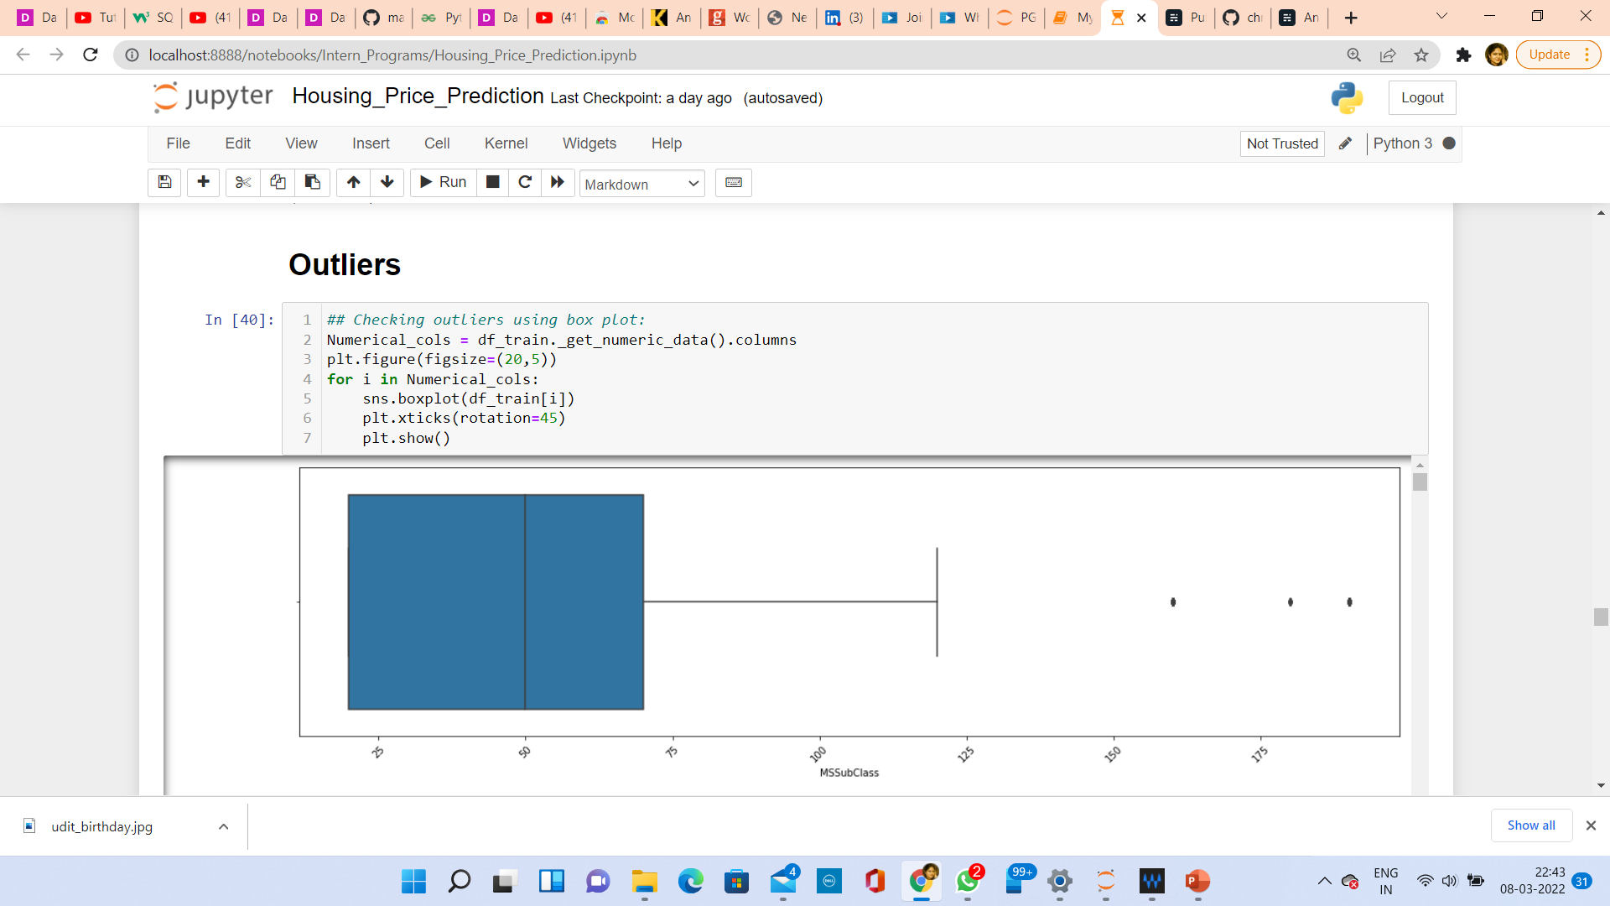

Slide 19
TREATING SKEWNESS
In the Data Science it is just statistics and many algorithms revolve around the assumption that the data is normalized. So, the more the data is close to normal, the better it is for getting good predictions. There are many ways of transforming skewed data such as log transform, square-root transform, box-cox transform, etc.
1. Log Transform
Log transformation is a data transformation method in which it replaces each variable x with a log(x). The log transformation is, arguably, the most popular among the different types of transformations used to transform skewed data to approximately conform to normality
2. Square Root Transform
The square root, x to x^ (1/2) = sqrt(x), is a transformation with a moderate effect on distribution shape: it is weaker than the logarithm and the cube root. It is also used for reducing right skewness, and also has the advantage that it can be applied to zero values. So, applying a square root transform inflates smaller numbers but stabilizes bigger ones.
3. Power Transformer
In statistics, a power transform is a family of functions that are applied to create a monotonic transformation of data using power functions. This is a useful data transformation technique used to stabilize variance, make the data more normal distribution-like, improve the validity of measures of association such as the Pearson correlation between variables and for other data stabilization procedures.

Slide 20
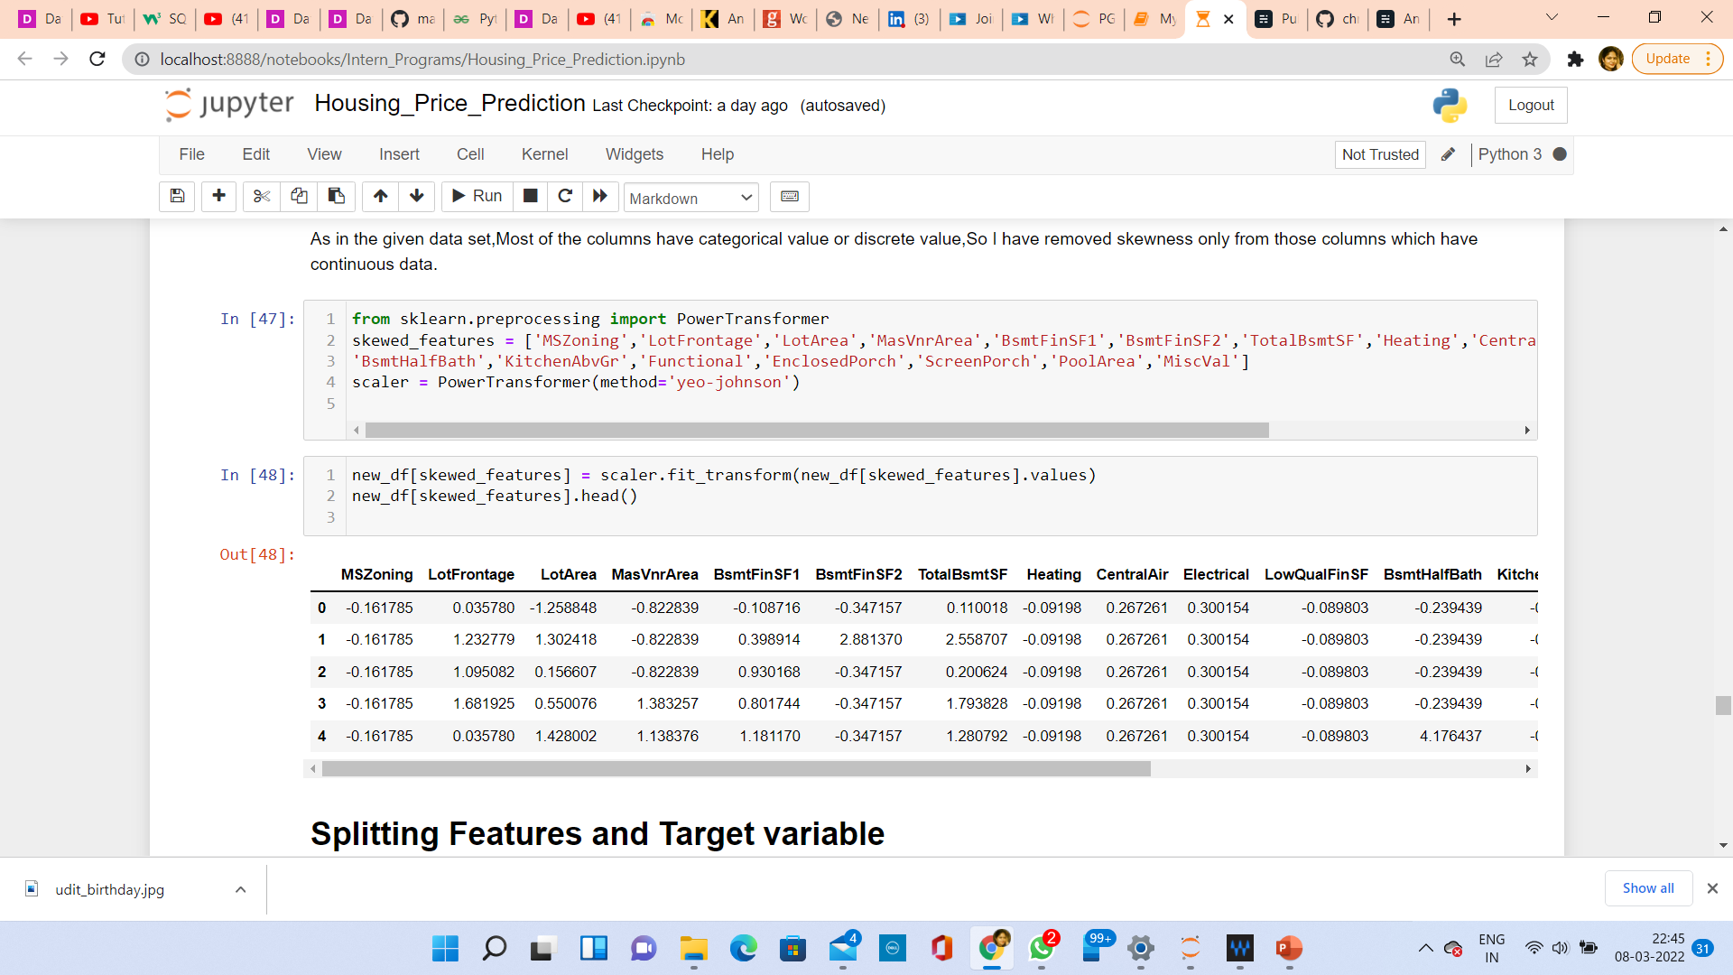

Slide 21
HARDWARE AND SOFTWARE REQUIREMENTS AND TOOLS USED
For doing this project, the hardware used is a laptop with high end specification and a stable internet connection. While coming to software part, I had used anaconda navigator and in that I have used Jupyter notebook to do my python programming and analysis.
For using a csv file, Microsoft excel is needed. In Jupyter notebook, I have used lots of python libraries to carry out this project and I have mentioned below with proper justification:
1. Pandas- a library which is used to read the data, visualisation and analysis of data.
2. NumPy- used for working with array and various mathematical techniques.
3. Seaborn- visualization tool for plotting different types of plot.
4. Matplotlib- It provides an object-oriented API for embedding plots into applications.
5. zscore- technique to remove outliers.
6. skew ()- to treat skewed data using various transformation like sqrt, log, cube, PowerTransformer, etc.
7. PCA- I used this to reduce the data dimensions to 10 columns.
8. standard scaler- I used this to scale my data before sending it to model.
9. train_test_split- to split the test and train data.
10. Then I used different Regression algorithms to find out the best model for predictions.
11. Pickle - library used to save the model in either pickle or obj file.

Slide 22
MODEL/S DEVELOPMENT AND EVALUATION
From the given dataset it can be concluded that it is a Regression problem as the output column “SalePrice” has continuous output. So, for further analysis of the problem, I have to import or call out the Regression related libraries in Python work frame.
The different libraries used for the problem solving are:
Sklearn
Sklearn.linear_model
Sklearn.ensemble
Sklearn.metrics
Sklearn.model_selection

Slide 23
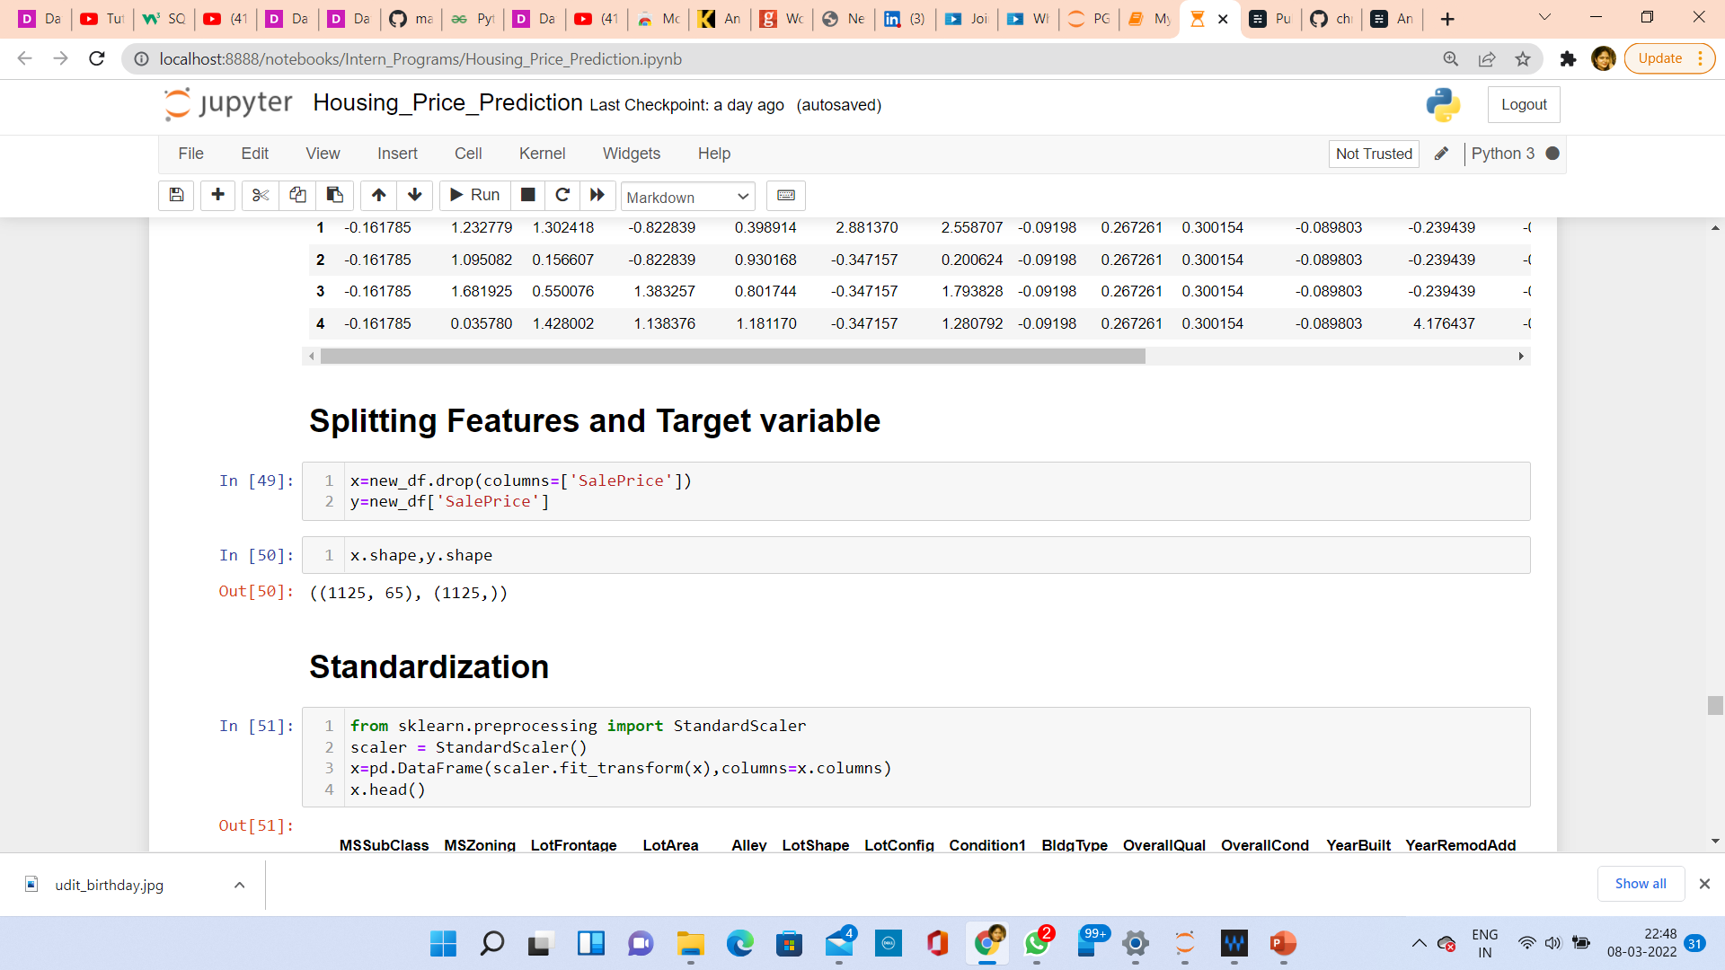
TESTING OF IDENTIFIED APPROACHES
After completing the required pre-processing techniques for the model building data is separated as input and output columns before passing it to the train_test_split.

Slide 24
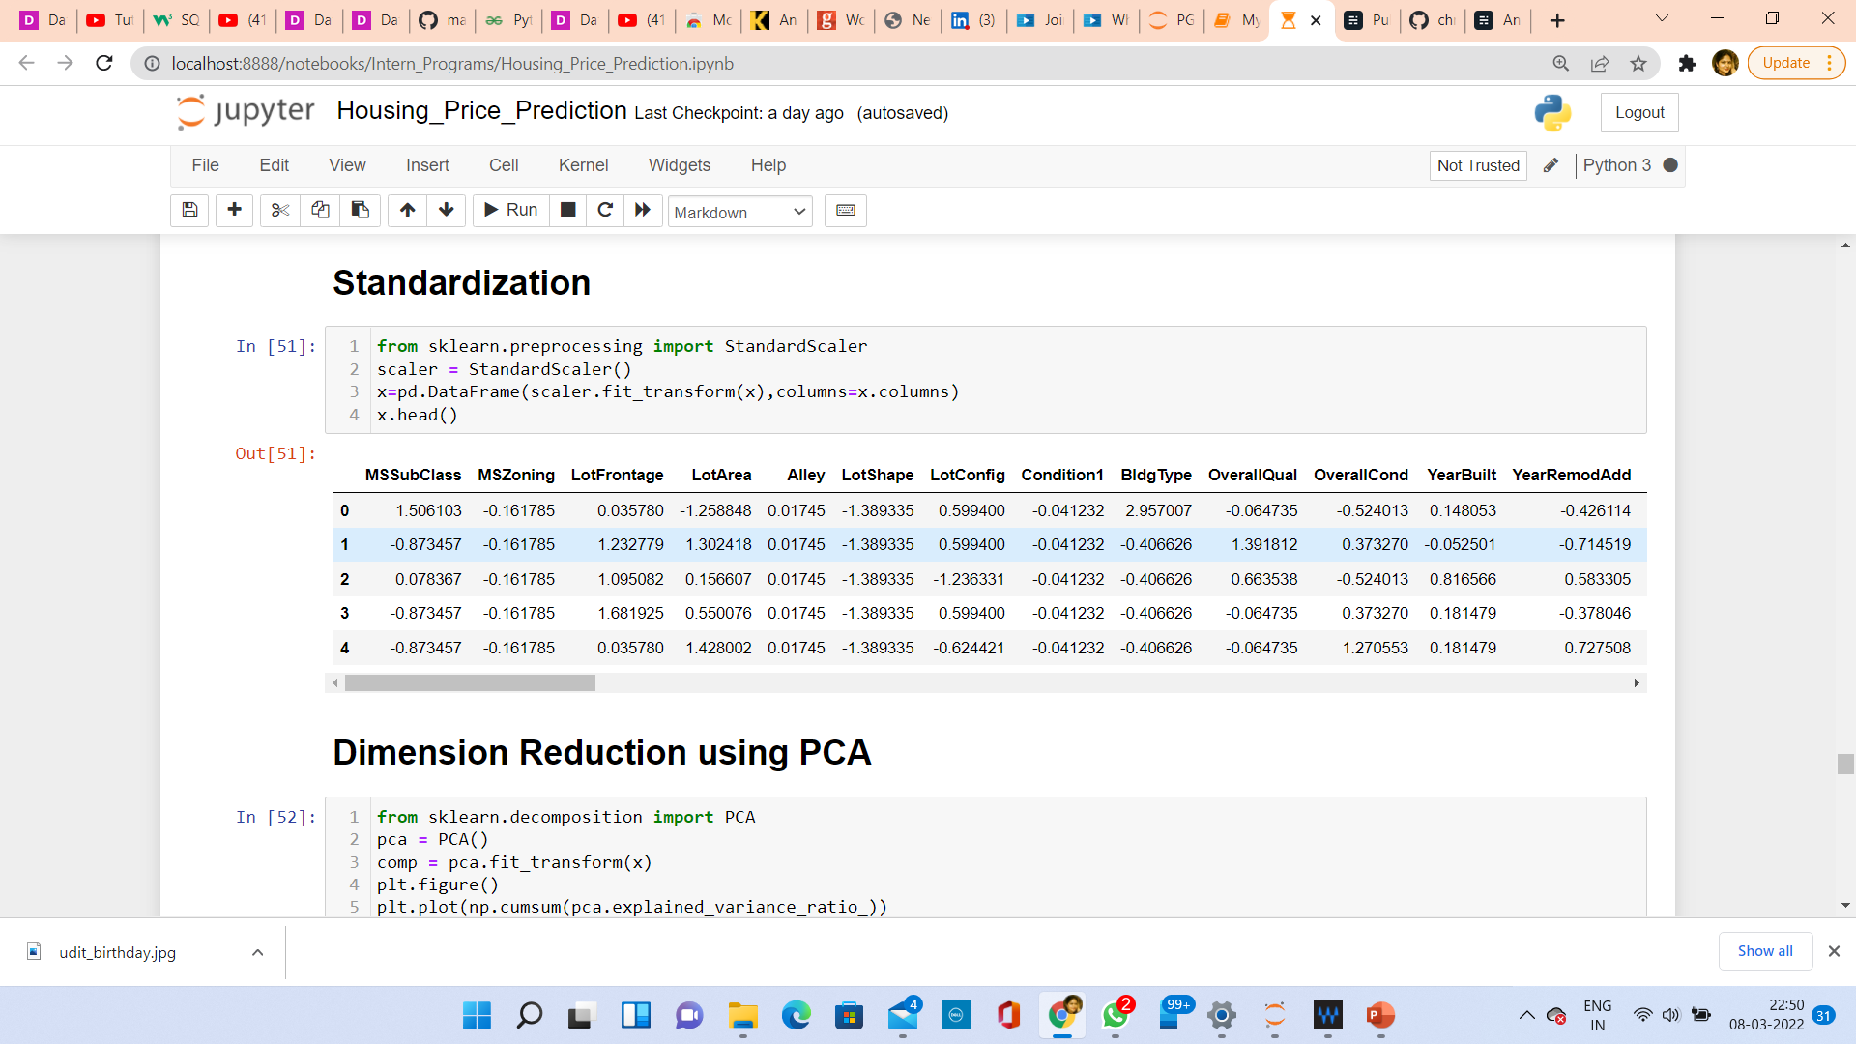
SCALING THE DATA USING STANDARD SCALER
For each value in a feature, StandardScaler subtracts the minimum value in the feature and then divides by the range. The range is the difference between the original maximum and original minimum. StandardScaler preserves the shape of the original distribution.

Slide 25
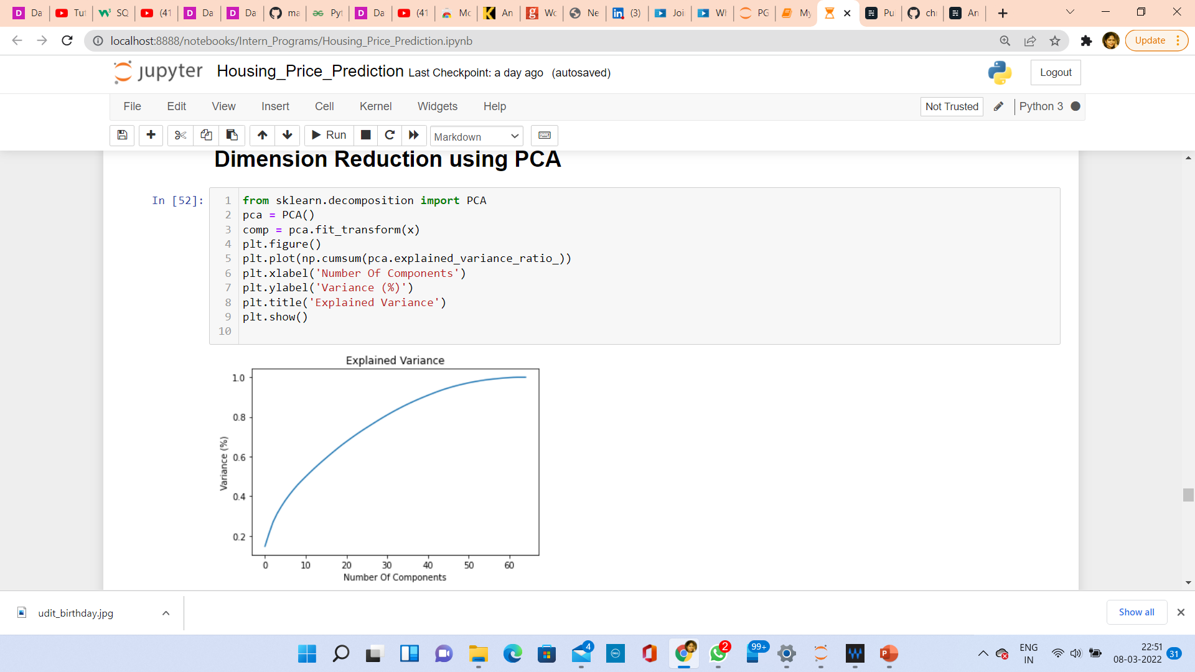
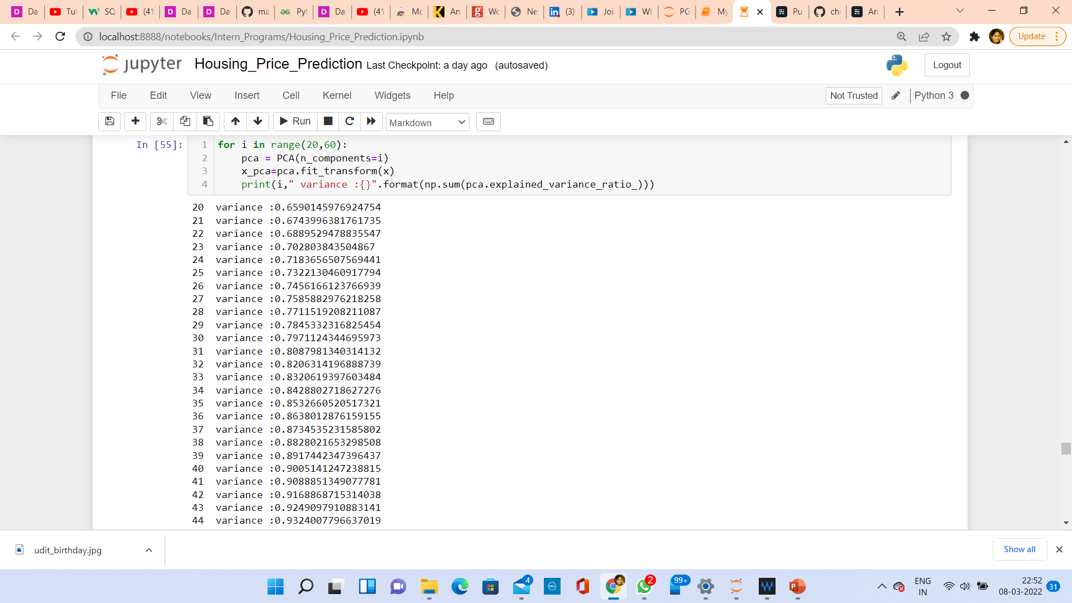
USING PCA
An important machine learning method for dimensionality reduction is called Principal Component Analysis. It is a method that uses simple matrix operations from linear algebra and statistics to calculate a projection of the original data into the same number or fewer dimensions.

Slide 26
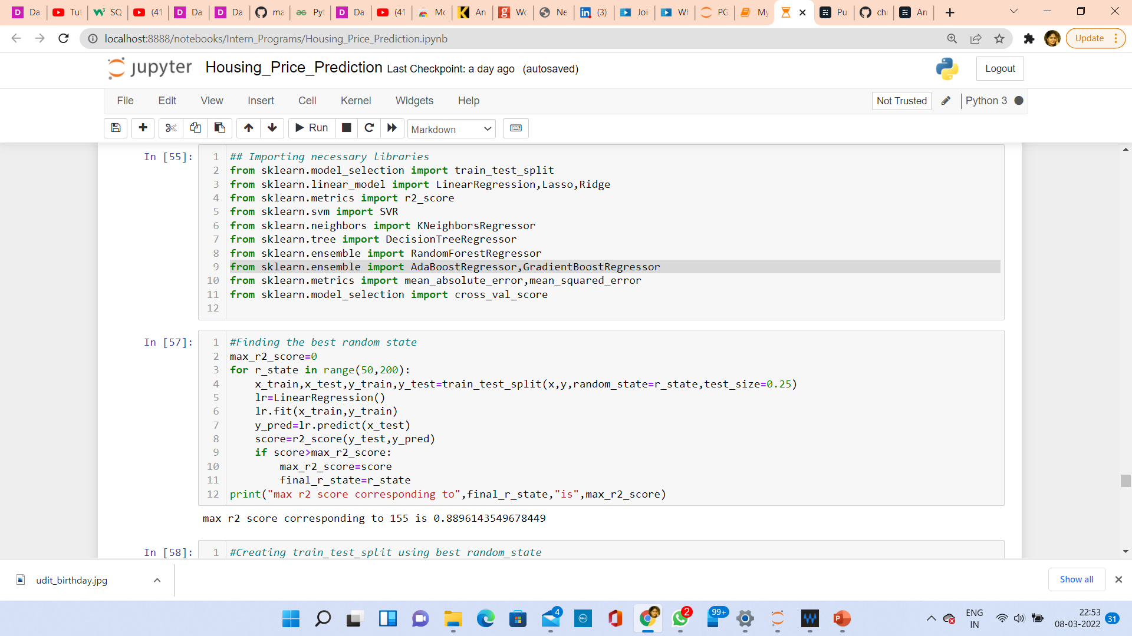
RUN AND EVALUATE SELECTED MODELS
We will find the best random state value so that we can create our train_test_split

Slide 27
Scikit-learn is a Python library that offers various features for data processing that can be used for classification, clustering, and model selection. Model_selection is a method for setting a blueprint to analyze data and then using it to measure new data. Selecting a proper model allows you to generate accurate results when making a prediction. If we have one dataset, then it needs to be split by using the Sklearn train_test_split function first. By default, Sklearn train_test_split will make random partitions for the two subsets.
The train_test_split is a function in Sklearn model selection for splitting data arrays into two subsets: for training data and for testing data. With this function, we don't need to divide the dataset manually. The train_test_split function is for splitting a single dataset for two different purposes: training and testing. The testing subset is for building your model. The testing subset is for using the model on unknown data to evaluate the performance of the model.
#Creating train_test_split using best random_state
x_train,x_test,y_train,y_test=train_test_split(x,y,random_state=85,test_size=.20)
Now, we will run a for loop for all regression algorithms and find the best model

Slide 28
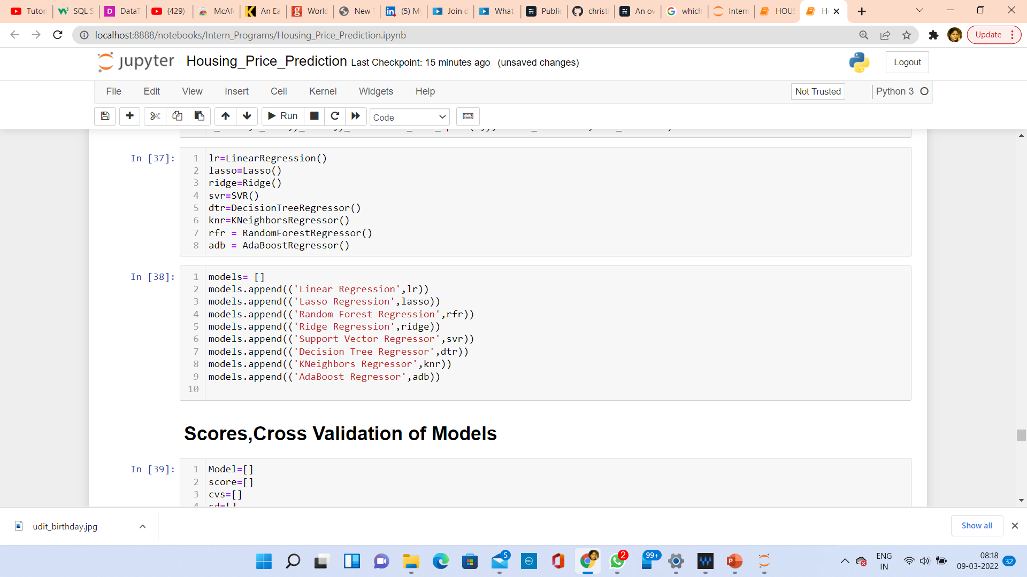
As you can see above, I had called the algorithms, then I called the empty list with the name models [ ], and calling all the model one by one and storing the result in that.
We can observe that I imported the metrics in order to interpret the model’s output. Then I also selected the model to find the cross_validation_score value.

Slide 29
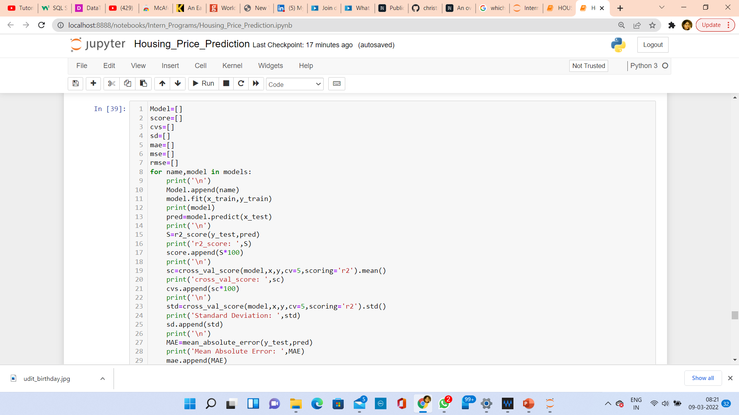
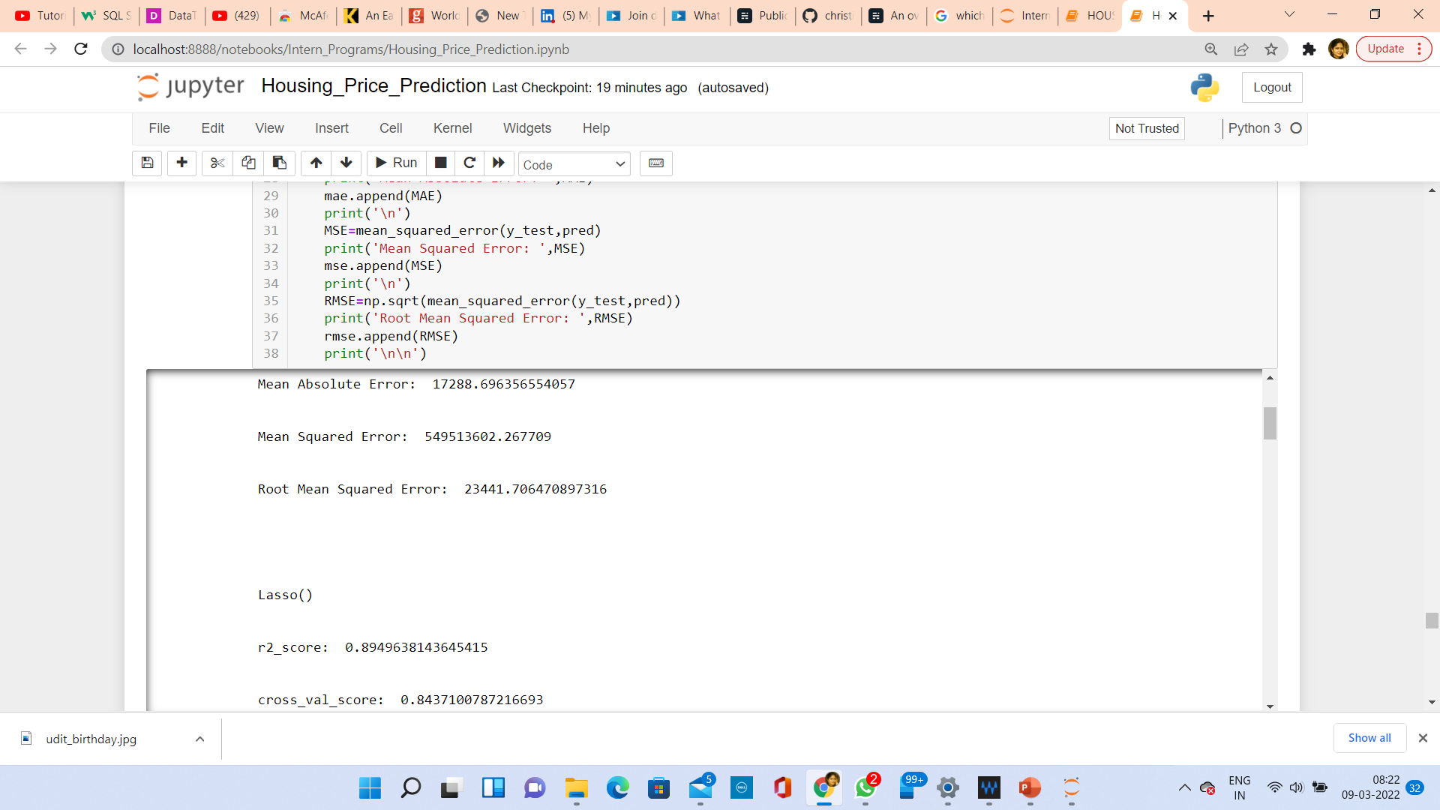
rmse.append(RMSE) print('\n\n') #Last 2 lines
As you can observe above, I made a for loop and called all the algorithms one by one and appending their result to models. The same I had done to store MSE, RMSE, MAE, SD and cross validation score. Let me show the output so that we can glance the result in more appropriate way.

Slide 30
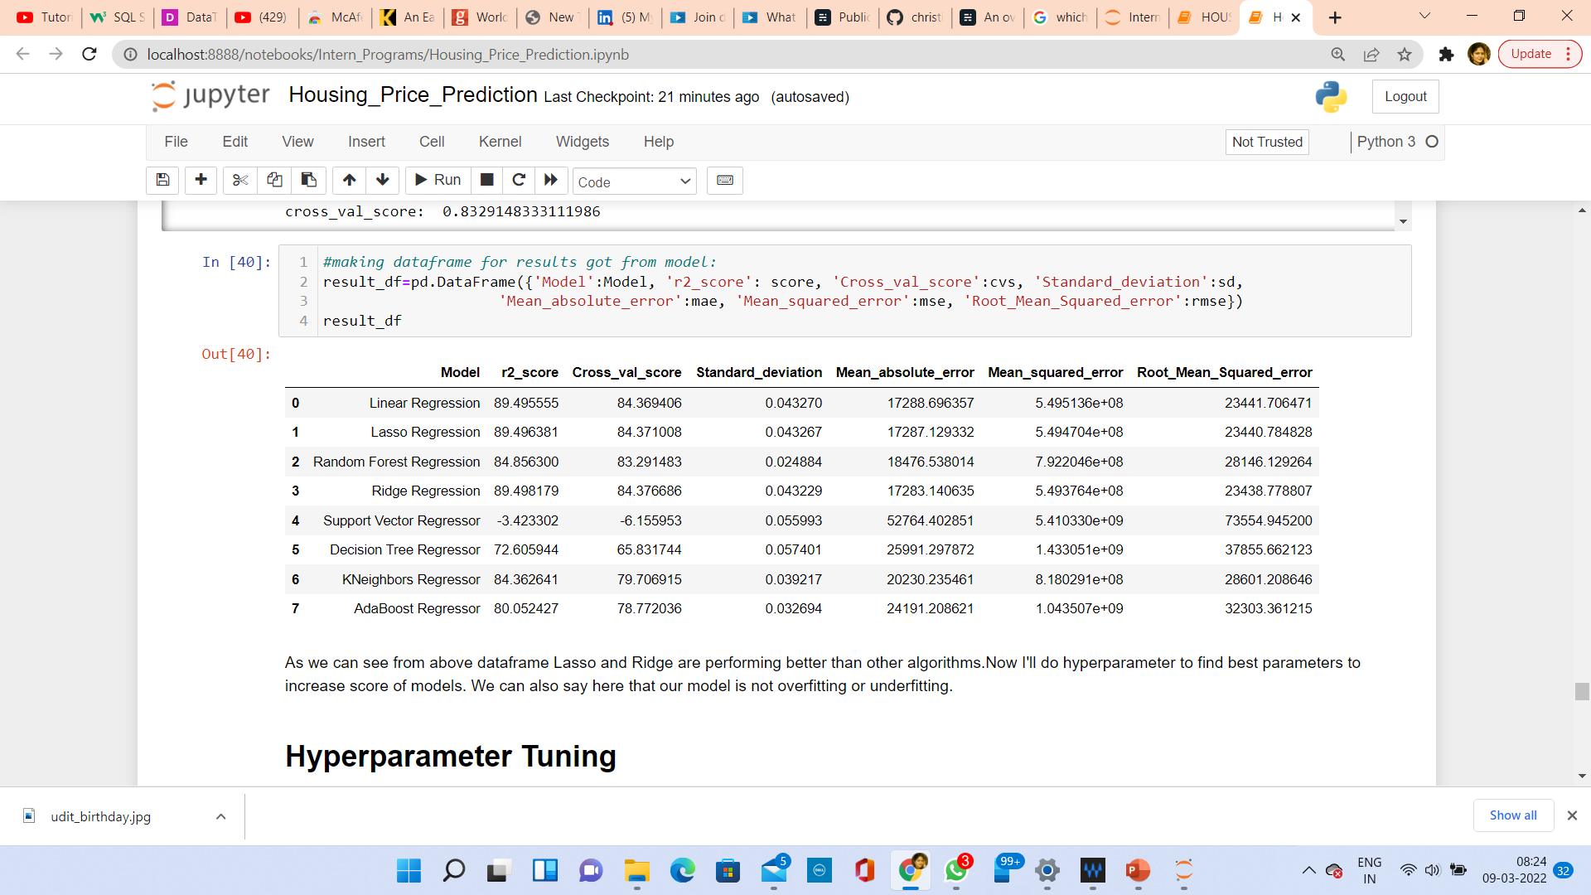
The following are the outputs of the different algorithms I had used, along with the metrics score obtained and after finalizing the outputs in a data frame, it will be as follows:
We can see that Ridge and Lasso Regression algorithms are performing well, as compared to other algorithms. Now we will try Hyperparameter Tuning to find out the best parameters and try to increase their scores.

Slide 31
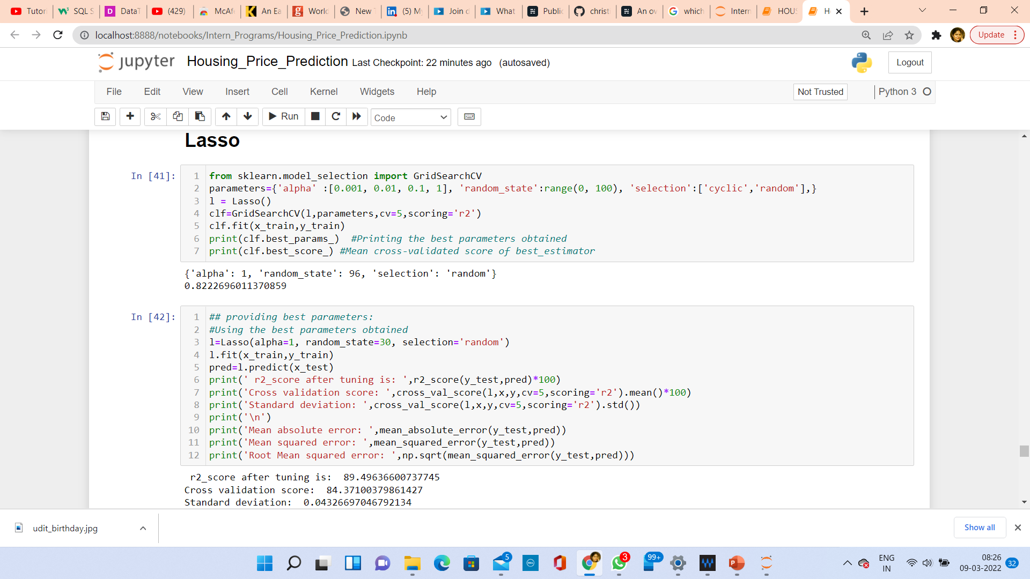
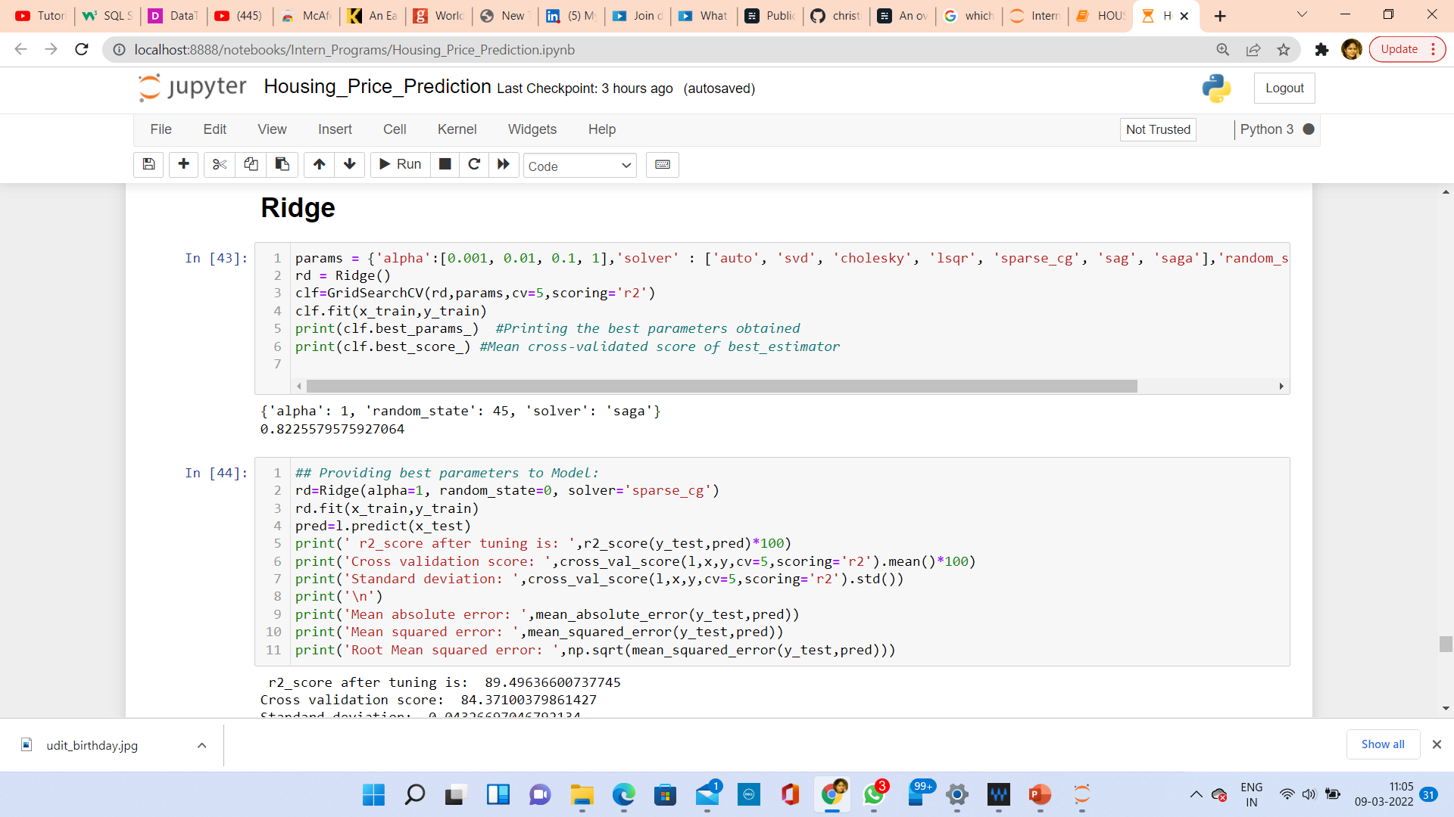
KEY METRICS FOR SUCCESS IN SOLVING PROBLEM UNDER CONSIDERATION
The key metrics used here were r2_score, cross_val_score, sd, MAE, MSE and RMSE. We tried to find out the best parameters and also to increase our scores by using Hyperparameter Tuning and we will be using GridSearchCV method.

Slide 32
After Tuning the best algorithms, we can see that Lasso Regression has been improved slightly, i.e., r2_score from 91.09175 to 91.09179 and the errors have been decreased. Now, we will try Ensemble techniques like RandomForestRegressor, AdaBoostRegressor and GradientBoostingRegressor to boost up our scores.

Slide 33
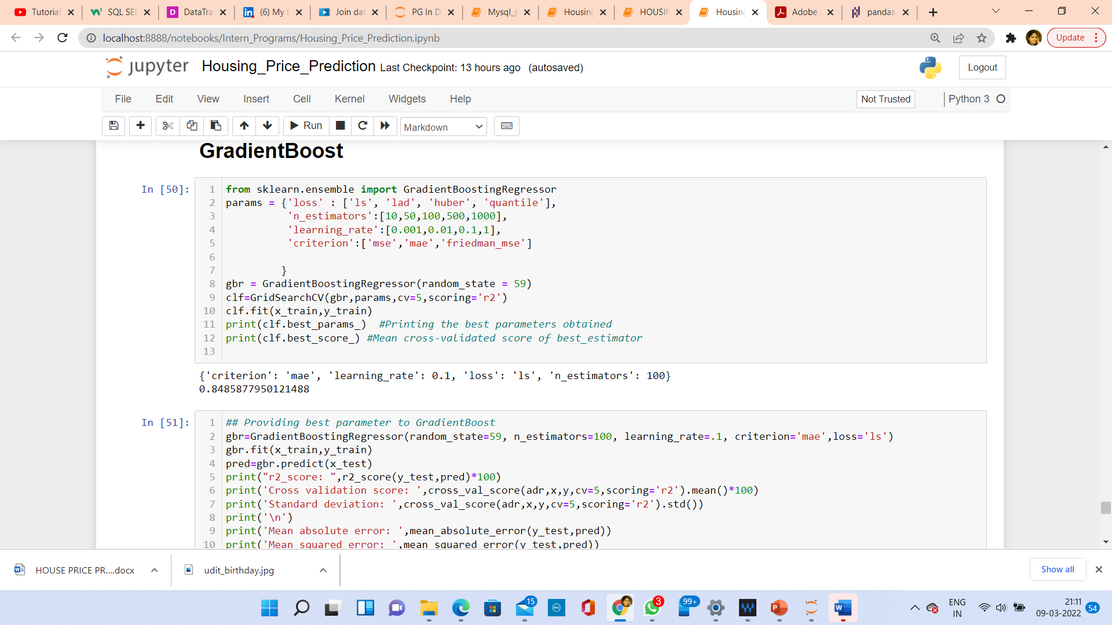
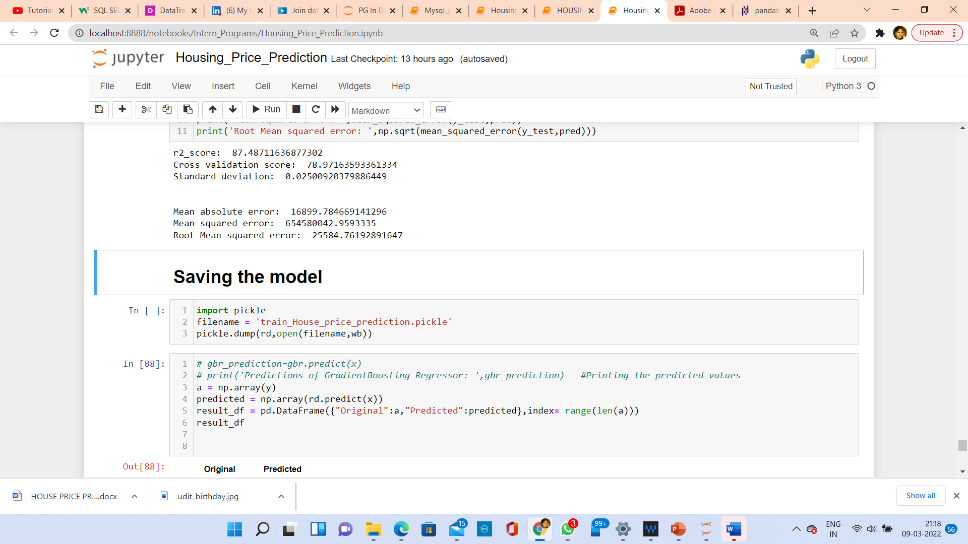
After applying Regularization, Ensemble Techniques, we can see that LinearRegression, Lasso, Ridge regressor, and Random Forest is the best performing algorithm among all other algorithms as it is giving a r2_score of 89.49 and cross validation score of 84.37. It has also the less amount of error values obtained. Lesser the RMSE score, the better the model. Now we will finalize the model.

Slide 34
FINALIZE THE MODEL

Slide 35
USING THE TEST DATASET AND DOING PRE-PROCESSING
Here, we will be doing the same steps as we did for training dataset like handling missing data, dropping unnecessary columns, encoding non-categorical data, treating skewness, etc.
Then, we will scale the data and do PCA analysis according to the best model requirements.

Slide 36
PREDICTING OVER TEST DATA

Slide 37
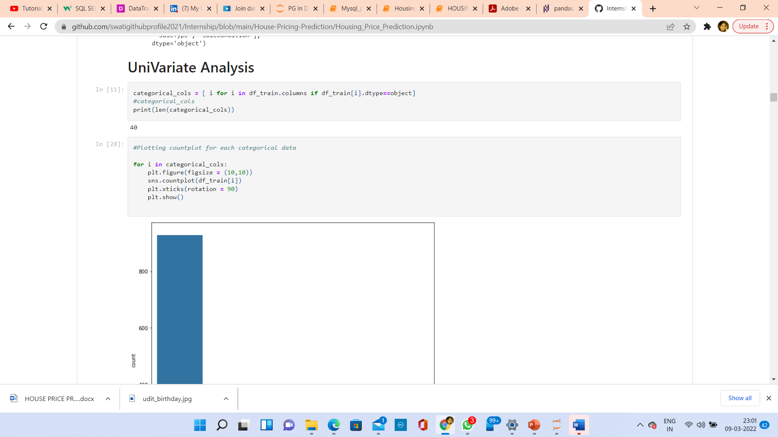
DATA VISUALIZATION
Now, we will see the different plots done with this dataset in order to know the insight of the data present. Below are the codes given for the plots and the output obtained:

Slide 38
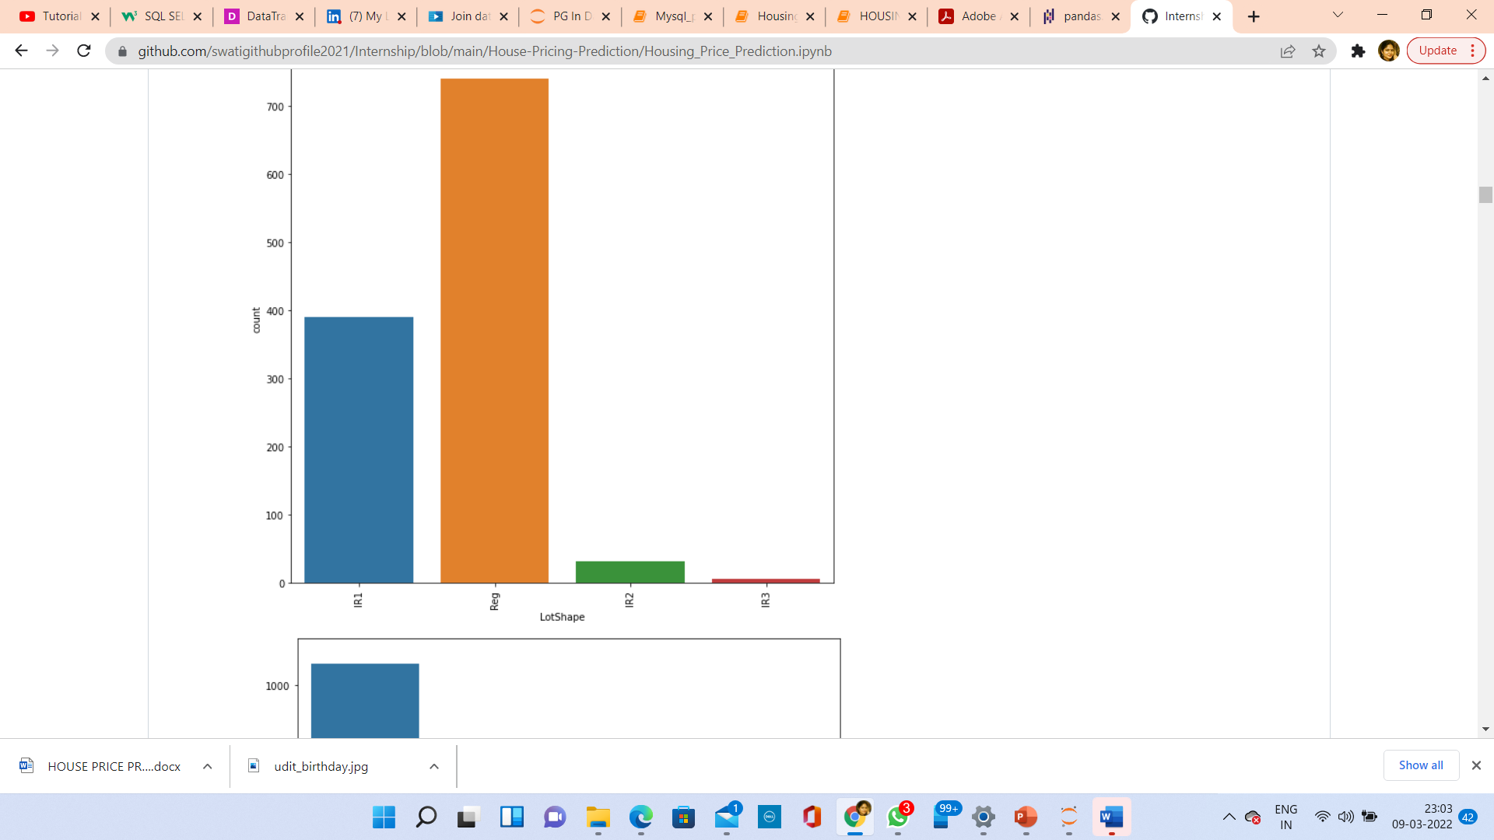
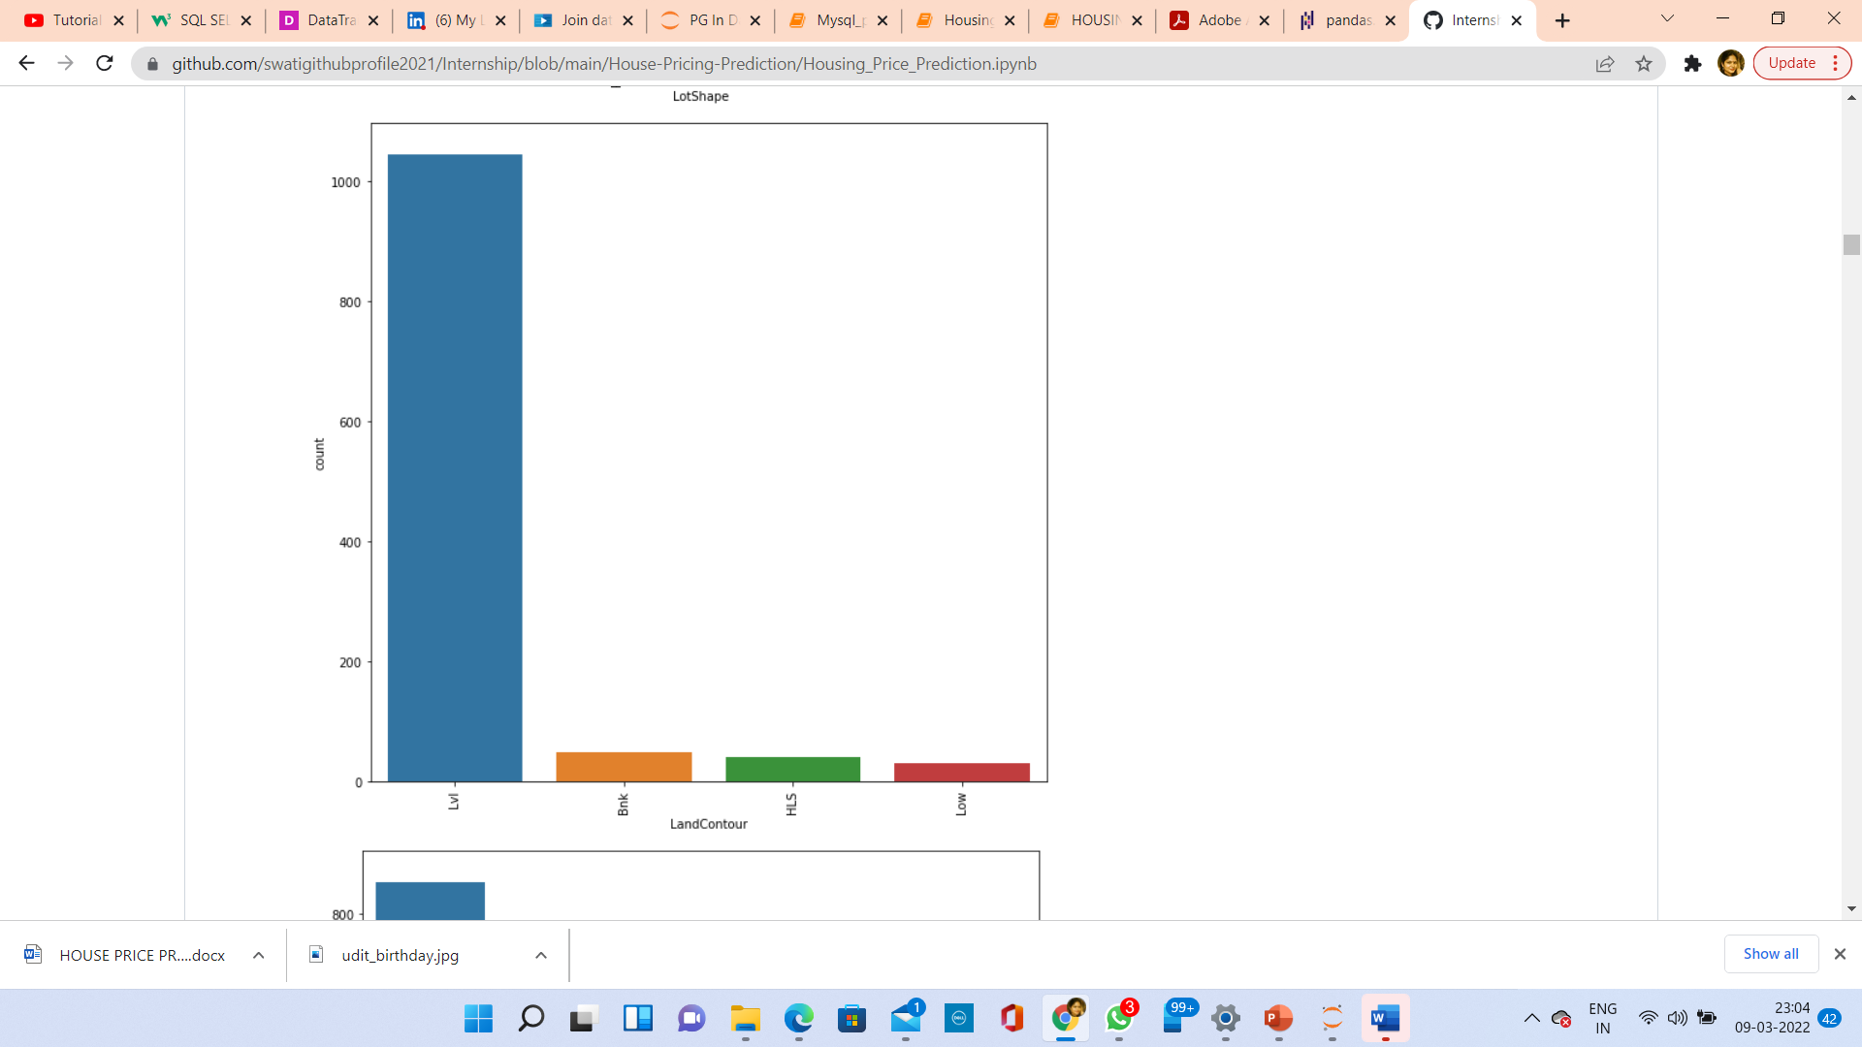
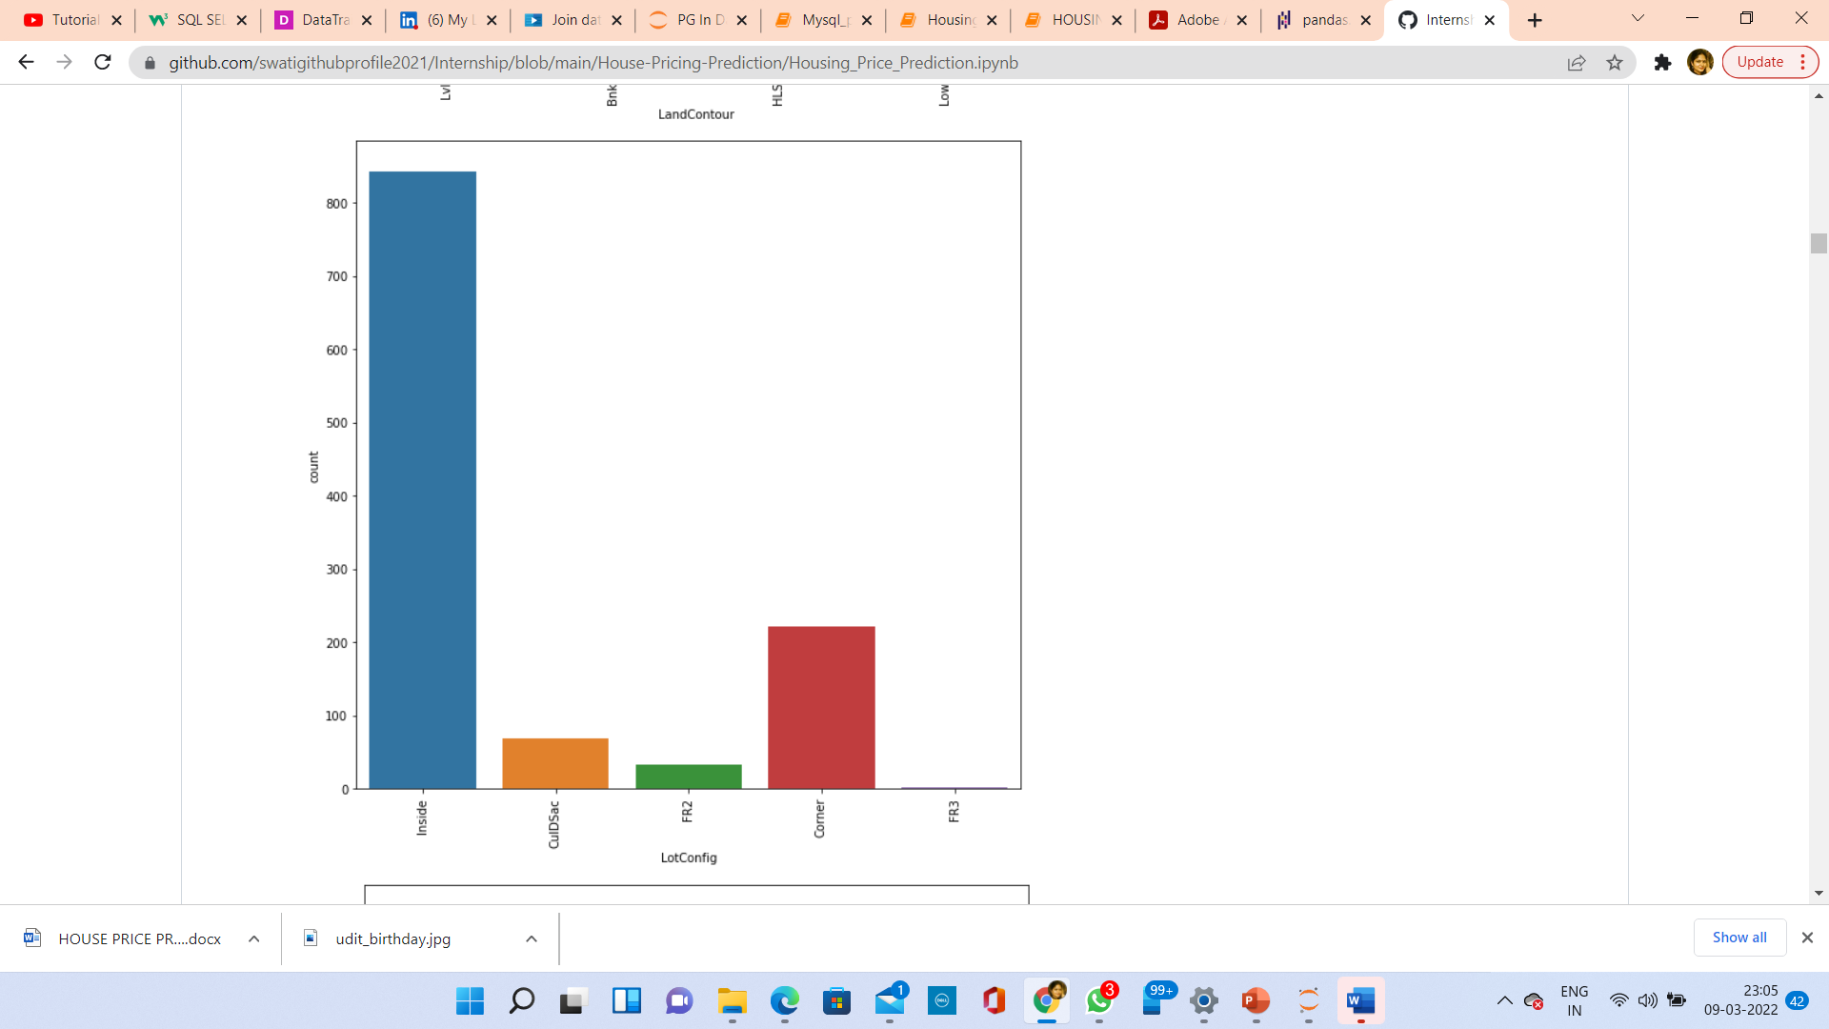
PLOTTING GRAPHS FOR CATEGORICAL DATA

Slide 39
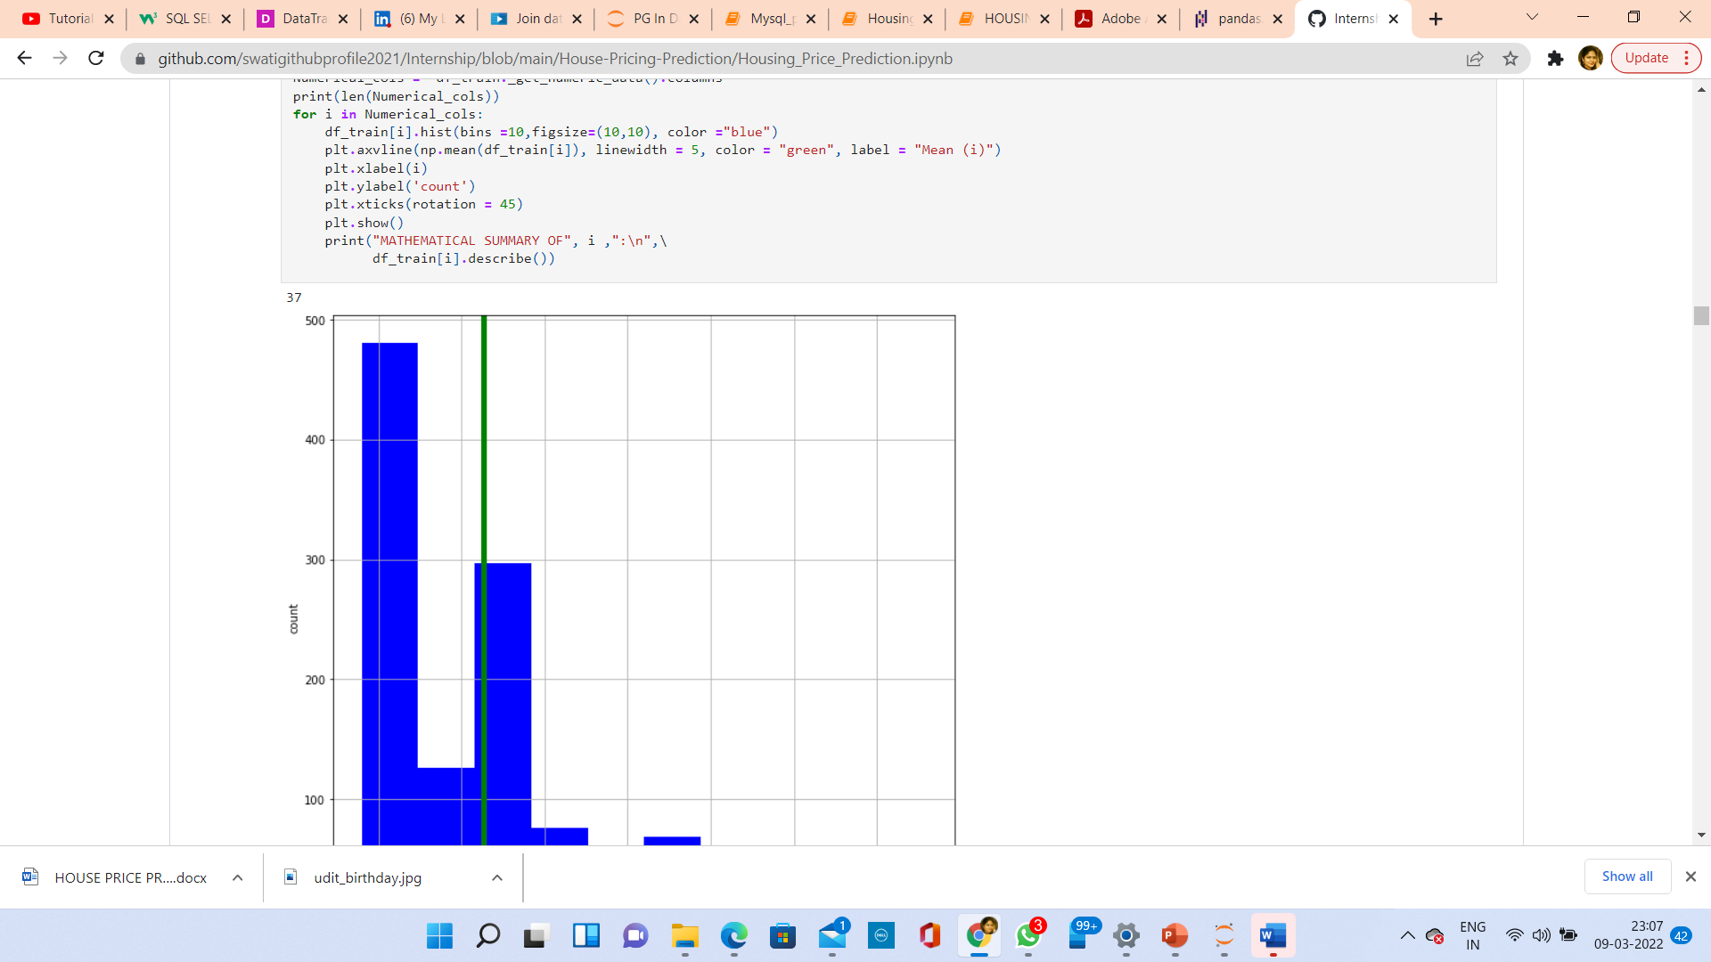
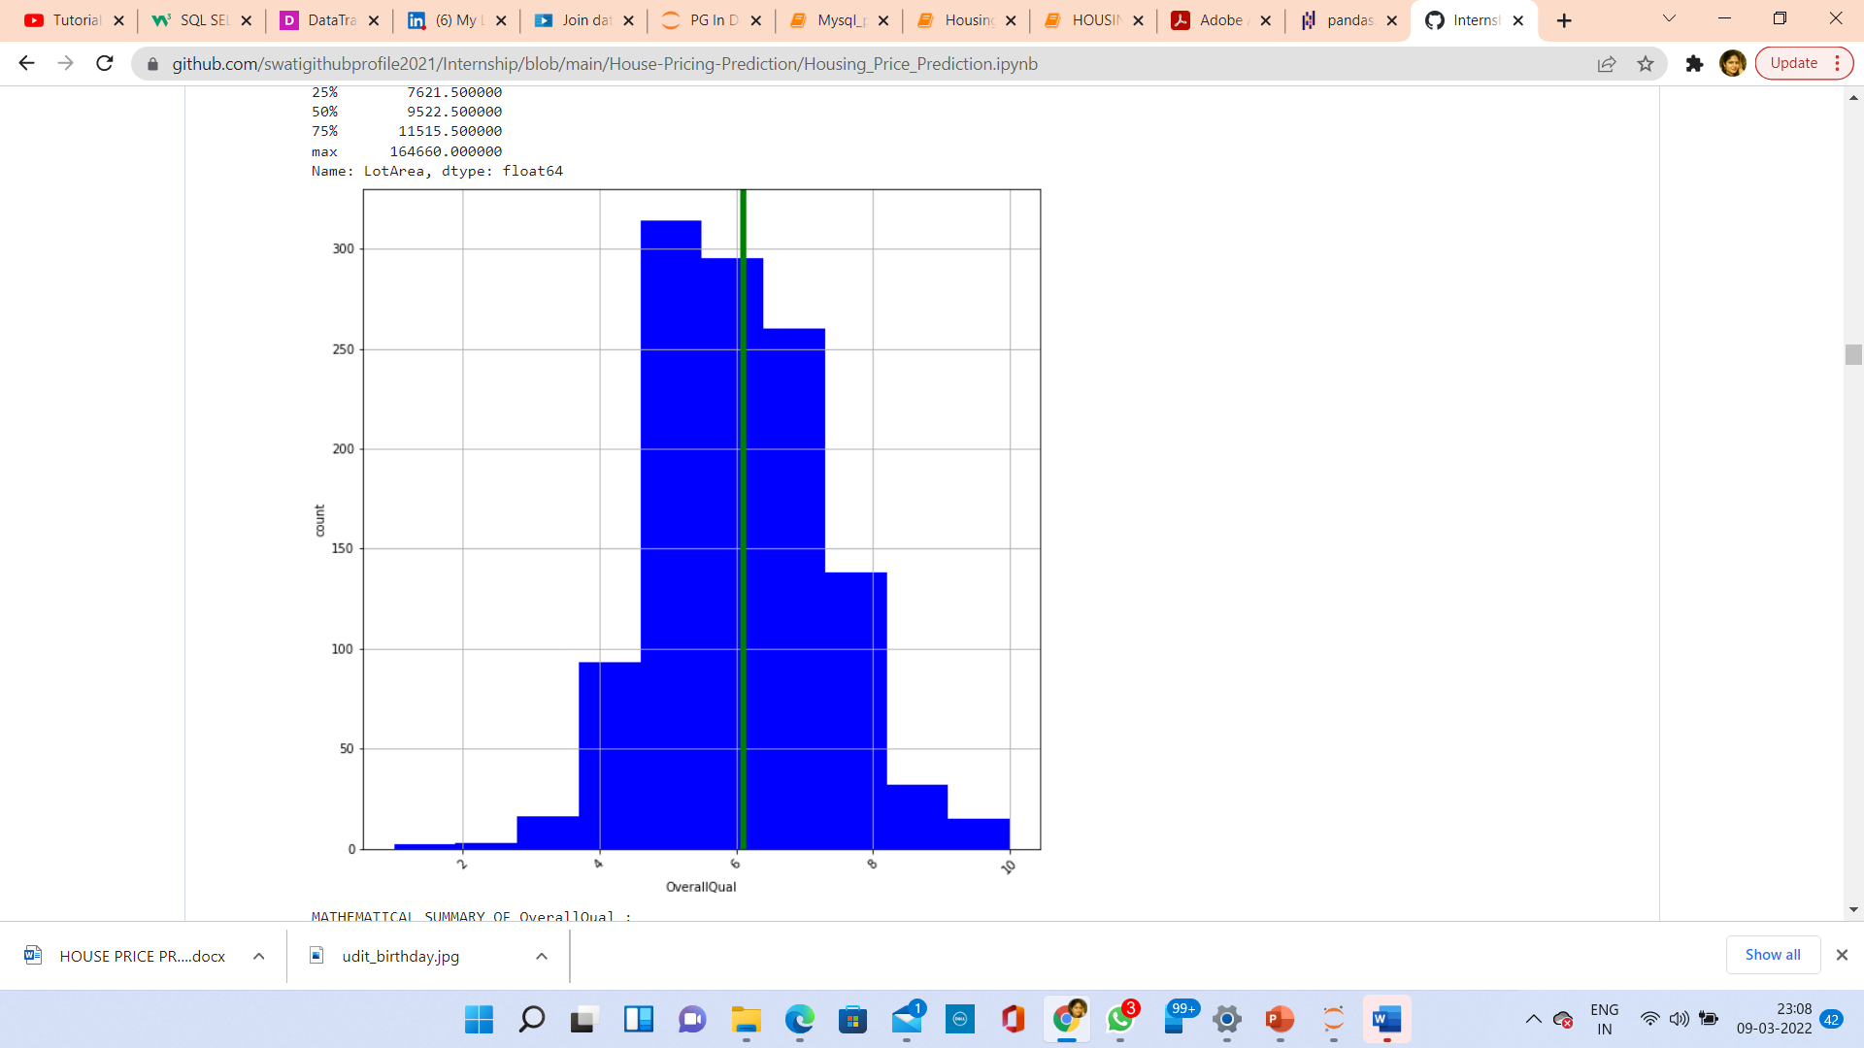
TAKING ALL CONTINUOUS DATA AND PLOTTING HISTOGRAM

Slide 40
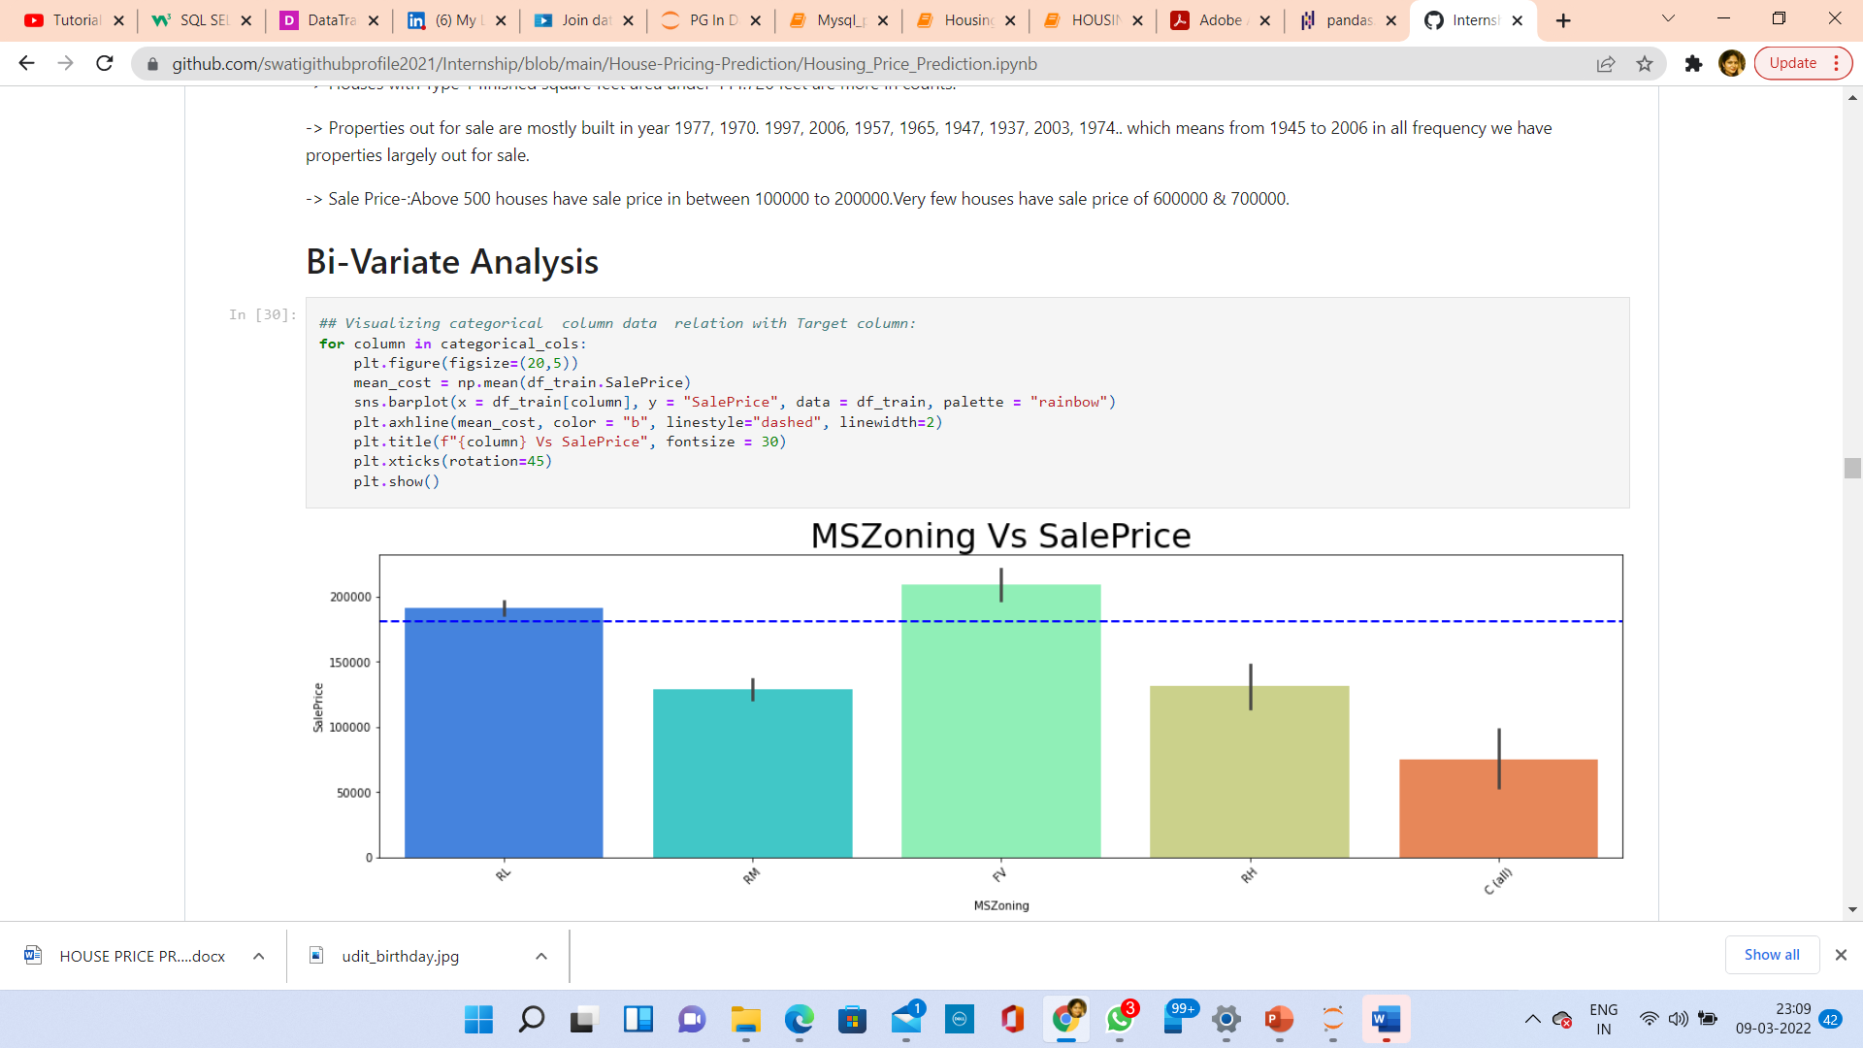
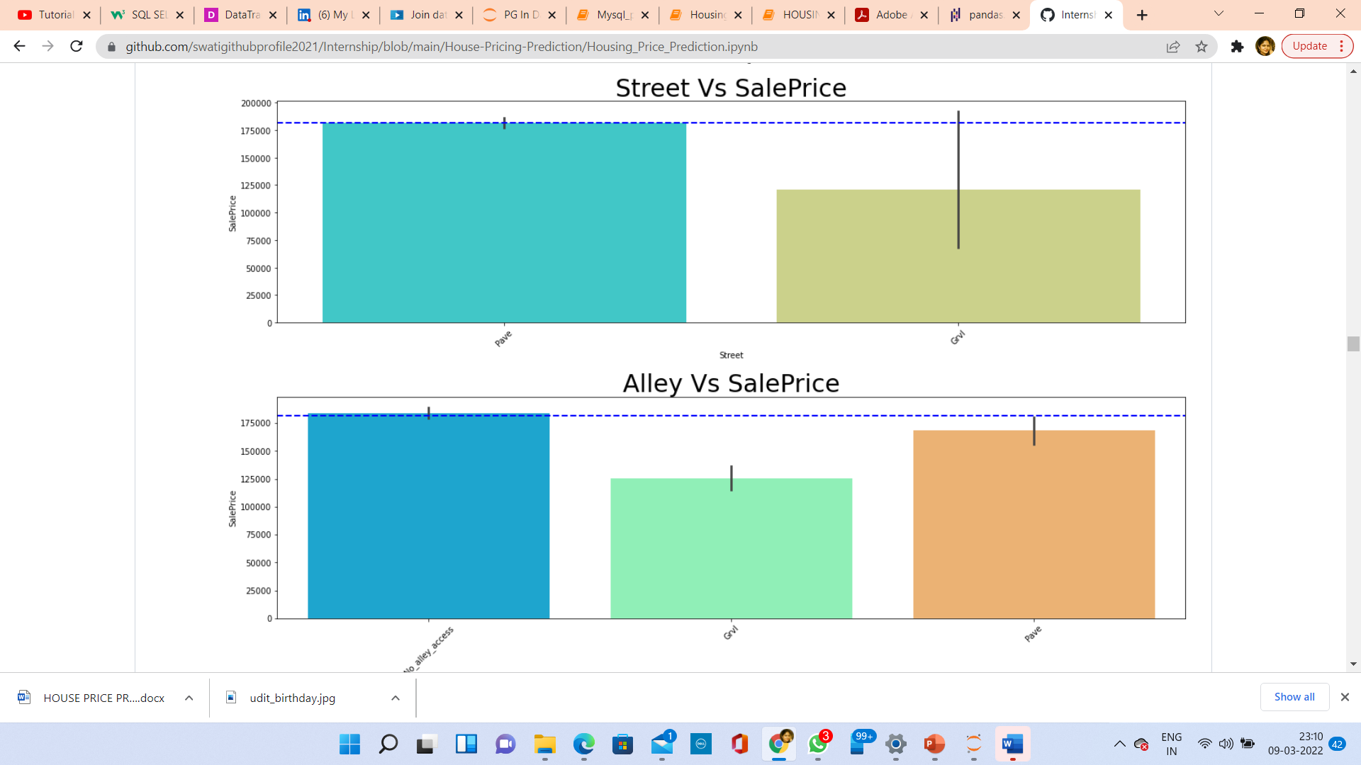
BIVARIATE ANALYSIS WITH SALESPRICE FOR CATEGORICAL DATA

Slide 41
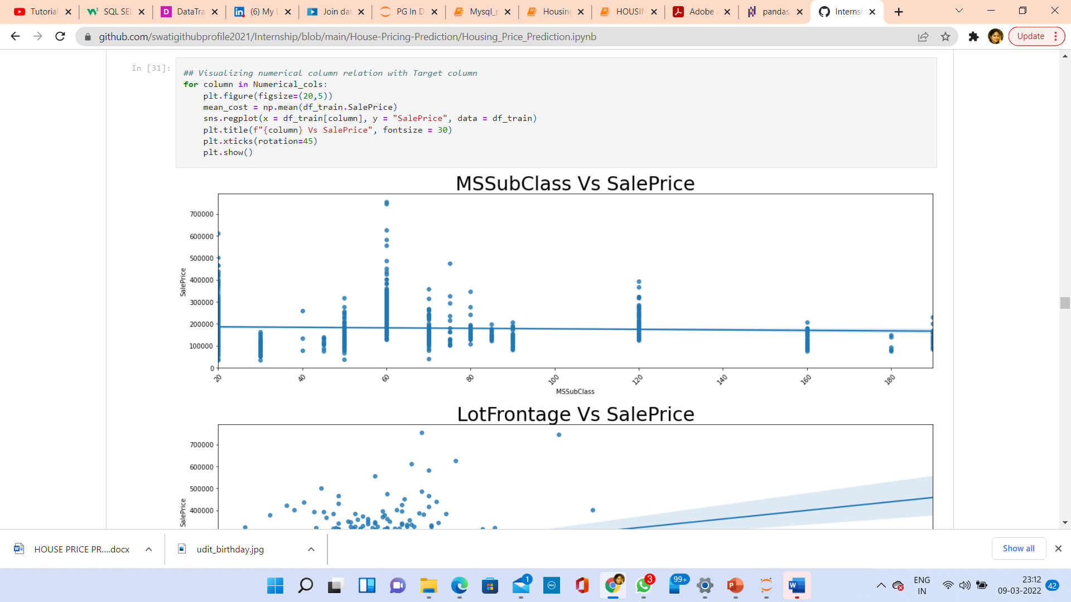
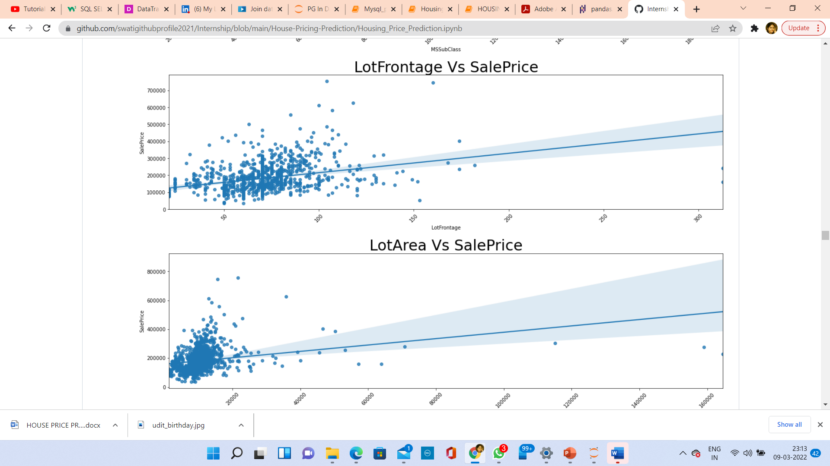
PLOTTING FOR CONTINUOUS DATA

Slide 42
CONCLUSION
After getting an insight of this dataset, we were able to understand that the Housing prices are done on basis of different features.
First, I loaded the train dataset and did the EDA process and other pre-processing techniques like skewness check and removal, handling the outliers present, filling the missing data, visualizing the distribution of data, etc.
Then I did the model training, building the model and finding out the best model on the basis of different metrices scores we got like Mean Absolute Error, Mean squared Error, Root Mean Squared Error, etc.
I got Lasso Regressor as the best algorithm among all as it gave more r2_score and cross_val_score. Then for finding out the best parameter and improving the scores, we performed Hyperparameter Tuning.
As the scores were not increased, we also tried using Ensemble Techniques like RandomForestRegressor, AdaBoostRegressor and GradientBoostingRegressor algorithms for boosting up our scores. Finally, I concluded that RandomForestRegressor was the best performing algorithm, although there were more errors in it and it had less RMSE compared to other algorithms. It gave an r2_score of 89.49 and cross_val_score of 84.37 which is the highest scores among all.
I saved the model in a pickle with a filename in order to use whenever we require.
Then I used the test dataset and performed all the pre-processing pipeline methods to it.

Slide 43
After treating skewness, I loaded the saved model that I obtained and did the predictions over the test data and then saving the predictions separately in a csv file.
From this project, I learnt that how to handle train and test data separately and how to predict the values from them. This will be useful while I’ll work in a real-time case study as I can get any new data from the client I work on and I can proceed my analysis by loading the best model I obtained and start working on the analysis of the new data I have.
The final result will be the predictions I get from the new data.
Overall, I can say that this dataset is good for predicting the Housing prices using regression analysis and RandomForestRegressor is the best working algorithm model I obtained.
I can improve the data by adding more features that are positively correlated with the target variable, having less outliers, normally distributed values, etc.

Slide 44
LEARNING OUTCOMES OF THE STUDY IN RESPECT OF DATA SCIENCE
Price Prediction modeling – This allows predicting the prices of houses & how they are varying in nature considering the different factors affecting the prices in the real time scenarios.
Prediction of Sale Price – This helps to predict the future revenues based on inputs from the past and different types of factors related to real estate & property related cases. This is best done using predictive data analytics to calculate the future values of houses. This helps in segregating houses, identifying the ones with high future value, and investing more resources on them.
Deployment of ML models – The Machine learning models can also predict the houses depending upon the needs of the buyers and recommend them, so customers can make final decisions as per the needs.
I see how to deal with outliers when all the rows have at least one value Z>3.
To do a visualization when data has high standard deviation and no Classification

Slide 45
LIMITATIONS OF THIS WORK AND SCOPE FOR FUTURE WORK
1. The biggest limitation I observed was that not all categories of a particular feature were available in the training data. So, if there were new category in the test data the model would not be able to identify that.
Example: MSZoning has 8 categories
A Agriculture
C Commercial
FV Floating Village Residential
I Industrial
RH Residential High Density
RL Residential Low Density
RP Residential Low-Density Park
RM Residential Medium Density
2. However in the Training dataset only 5 categories are present, what happen if other 3 categories will present in test data in future. It would be difficult for machine to identify and predict.
3. The high skewness of data reduces the effectivity
4.Many features have NaN values more than 50%, and imputation of them can decrease the effectiveness. And dropping them had the loss of data.
5.we can increase the efficiency of a model by selecting a better method to remove outliers and skewness also how to make the search of perfect model in a way that if we want to change some parameters in model then we don't have to run all the model again

Slide 46
Thank You.

